Slide 1

A Comprehensive Quality control Material for RVC
(Together with Measurement & Analysis Section for JB5001 Training)
Renesas Design VietNam Co., Ltd. Software engineering division
Minh N. Tran minh.tran.vf@renesas.com

Slide 2
agenda
Introduction and Related Work ⁽¹⁾
Measurement ⁽²⁾
Analysis ⁽²⁾
Defect Management ⁽²⁾
Quantitative Quality Control (QQC) Indicators ⁽³⁾
QQC under Quality Management System ⁽³⁾
(1): introduction about QC activity and related work
(2): target of JB5001 development process training course (Section: Measurement and Analysis)
(3): additional works for Project Manager and Project Leader
Note: it is recommended to use the presentation slide show mode, since this material is using animation to handle the presentation flow.

Slide 3
Introduction and Related Works
Everything an engineer needs to know…
Page 3

Slide 4
CAPABILITY
QUALITY
TREND
RELIABLE
BUGS
CONTROL
DEFECTS
“Nothing is perfect.
If everything is perfect, then perfect is the problem.”
(RVC QC team)

Slide 5
(1) Cost of quality
Cost of quality
Cost of good quality (COGQ)
To maintain the high quality status
For example, cost of training to increase knowledge and skill level, or cost of investing on management system for efficiency management
Cannot be avoid since it’s necessary to maintain the quality level similar or higher than before
Cost of poor quality (COPQ)
To fix the failure on work
The failure can be either internal failure (bug in development) or external failure (issue of env.)
Can be avoid since most of times the root causes of failure are due to mistakes
Comparing between costs of quality
In general, COPQ > COGQ since COGQ is optimal under good management while COPQ cannot be forecasted under poor management.
Cost of poor quality
Cost of good quality
Internal failure cost
External failure cost
Re-design
Re-implementation
Re-testing
Re-inspections
COPQ leads to the cost of rework.

Slide 6
(1) Cost of quality
Cost of quality
High cost of bug-fixing over time!
Cost of poor quality
Cost of good quality
Internal failure cost
External failure cost
Re-design
Figure: Phase–wise Defect injection analysis with cost (From Arun Kumar Marandi and Danish Ali Khan, An impact of Linear Regression Models for Improving the Software Quality with Estimated Cost, 11th International Multi-Conference on Information Proceeding (IMCIP-2015))
Re-implementation
Re-testing
Re-inspections
Process Stage | Req. Spec. Review + High Level Design Review + Detail Design Review | Code reviews + UT | IT + ST | Acceptance Test
% of Total Defects | 15–20% | 50–70% | 20–28% | 5–10%
COPQ leads to the cost of rework.
Table: Defects distribution among process stage (From Pankaj Jalote et al., Quantitative Quality Management through Defect Prediction and Statistical Process Control, 2nd World Quality Congress for Software (2000))
A conventional defect distribution!

Slide 7
(1) Cost of quality
Process description:
Defect detection process: bugs found by peer review and by test execution ➔ Rework
Fixing bugs found by peer review is in-place ➔ low cost of fixing
Fixing bugs found by test execution is cycling ➔ high cost of fixing
Target to improve
Start
End
Figure: Phase–wise Defect injection analysis with cost (From Arun Kumar Marandi and Danish Ali Khan, 2015) (Recall)
N
BD/RD
BD/RD issue?
Has bug?
ST/VT
Y
Y
N
N
Y
FD/AD issue?
Has bug?
Review OK?
FD/AD
IT
N
Y
Y
N
N
Review OK?
Y
DD/UD
DD/UD issue?
Has bug?
UT
N
Y
N
Y
Y
Review OK?
CD
N
Preferable to utilize AMAP
Note: COPQ due to rework is detected in the stage of analyzing bugs found by test execution and are marked as red line in the figure.
Y
Review OK?
N
Figure: Process map for defect detection (Recall)

Slide 8
(1) Cost of quality
The survey of defects distribution (15S~16S) was showing high defects distribution rate ➔ high COPQ on the Testing phase
Early achievements (RVC ESW):
39.72% (15S) vs. 74.43% (18-2H) of bugs found by Peer Review
95.7% (18-2H) of bugs detected before IT and ST
Controlling development capability under CMMI Maturity Level 3
Note: PS - Purchase Spec.; Charts for terms 16K and 16S can be found from next slides.
PS count: 57
60.28%
39.72%
22.11%
Figure: Defects distribution among development phases – a survey from terms 15S to 16S. 15S – CMMI appraisal; 16K~16S – CMMI trial process
Note: PS - Purchase Spec.; Charts for terms 17-1H~18-1H can be found from next slides.
PS count: 99
74.43%
Improved from 17-1H~18-2H:
Lower COPQ on Testing phase ➔ lower cost of rework
25.57%
4.27%
Figure: Defects distribution among development phases – a survey from terms 17-1H and 18-2H (CMMI with JB5001)

Slide 9
(2-1) Quality Assurance And Quality control
Process Compliance Area
QA: Process is good, then following the process ➔ quality is good
Measurement and Analysis
QC: Trending is good as shown by analyzed data ➔ quality is good
V-model
Quality Control (QC)
Guaranteeing quality by checking status of quality indicators, then forecasting and consulting improvement plan
Measurement and Analysis
Quality Assurance (QA)
Guaranteeing quality by checking process compliance
Quality problems?
Data collection
Waterfall-model
Measurement and Analysis
Data analysis
Forecasting
Consulting
Agile-style
Quality Control Area

Slide 10
(2-2) 3-stages of quality Control
After that ➔ maintenance
When you can
When you can
MEASURE
CONTROL
IMPROVE
Then you can
Then you can
To build up the quantitative project measurable database for the statistical analysis. It’s used to understand the current development performance.
Quality control (QC) activity accepts the fact that issues or bugs will occur under a rate control.
QC activity proves that the project will provide a number of issues or bugs similar to what is being expected for that project.
When the development capability was confirmed as stable, it means the quality status reached to a certain level and in-control. Then a higher demand on quality level is need as continuous improvement.
QC activity means: (1) collecting data, (2) analyzing data, (3) predicting the future if the project still do what they did or plan to do, (4) improving the situation in the future by applying countermeasure.

Slide 11
(3-1) Development Capability
After that ➔ maintenance
+
When you can
When you can
MEASURE
CONTROL
IMPROVE
Then you can
Then you can
Stable and Predictable
Capability
Under the same Process and the same Training (knowledge + experience), the Output should be same.
Also, the Problems
But it is difficult to maintain the same Process, because there are always new people coming with different base-knowledge and experience ➔ Need a Training.
Additionally, the Process and Training (also a part of Process) may be changed ➔ Output may be changed.
Capability
Unpredictable

Slide 12
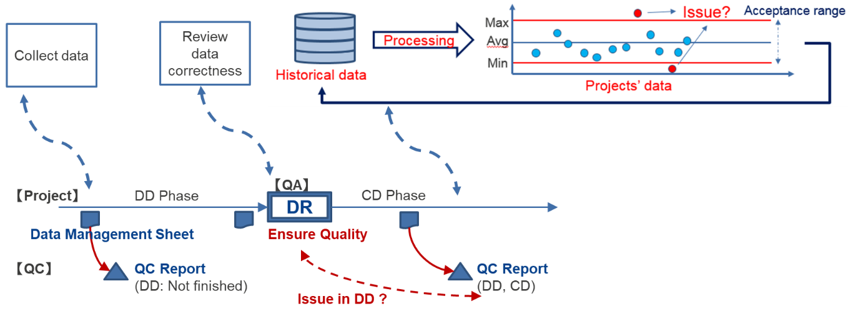
(3-2) Development Capability ➔ Process Database
Introduction
(Original name) QC Organization Data
Sometimes it is called as Historical Data
It is a quantitative statistical database from many projects within a development period.
Intention of use
Rich source of reference for project data estimation:
Under the same development process and skill level, projects that have same characteristics may refer quantitative measurable data from other projects for the plan estimation and control.
Rich source of capability evaluation:
Development capability of organization can be evaluated by statistical analysis.
Figure: Measurement and analysis (MA) in project integrating with quantitative quality control
Process Database V1.0
Period 13S~15K, ~99 projects (*)
Process Database V2.0
Period 13S~15S, ~140 projects (*)
Process Database V3.0, V3.1, V3.2
Period 15S~16S, 133 projects (*)
Process Database V4.0, V4.1
Period 17-1H~18-2H, 48 projects
(*) Due to the project management from that period, a long-run project was split to short-term individual projects
RVC SPO:
https://renesasgroup.sharepoint.com/:f:/r/sites/RVC/Shared%20Documents/1.%20General%20Documents/010_ENG/050_Software/2_SW%20Development%20Process/04_Common%20Experiences/06_Process%20Database?csf=1&web=1&e=pgS0Zi

Slide 13
(3-3) Development capability measurement
Only for reference and improvement
Global Process Database
From white papers, scientific papers, consulting services, etc.
~1.8 bugs per 10,000 LoC
(example)
REL Process Database
Some notes:
Same training, same skill, same process ➔ same performance ➔ forecast and prediction are possible (it’s quite difficult to understand why one is different from the crowd!)
Different organizations usually have different development capability and hence need to separate the Process Database.
RVC Process Database
Outsourcing Process Database
~2 bugs per 10,000 LoC
(example)
~5 bugs per 10,000 LoC
(example)
~8 bugs per 10,000 LoC
(example)
Cooperation
Coaching ➔ Cooperation
Simply speaking, THEIR performance is not OUR performance! Only we know us!

Slide 14
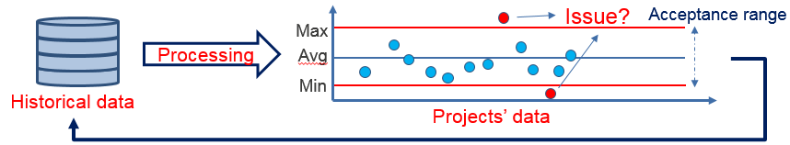
(3-4) Development Capability Under the Control Chart
Control charts, also known as Shewhart charts or process-behavior charts, are a statistical process control tool used to determine if a manufacturing or business process is in a state of control.
A control chart always has a central line to show the average (mean) of process state, an upper line (max) as upper control limit and a lower line (min) as lower control limit. Upper and lower lines form up to be a control range or acceptance range.
Data falling inside the control range has the same characteristics to build up the general performance. Data falling outside the control range will be considered as “abnormal” which usually means “they’re doing something weird comparing with others”.
The control chart is built from historical data, then is used as reference of performance or capability analysis for future data.

Slide 15
(3-5) Control Chart in 3-stages of quality management
After that ➔ maintenance
When you can
When you can
MEASURE
CONTROL
IMPROVE
Then you can
Then you can
Target of control is to make a compact control range
Max
Target of improvement is to improve the average line (either UP or DOWN)
Data point
Average
IN CONTROL AGAIN!
Min
Abnormal Data point ➔ Don’t care

Slide 16
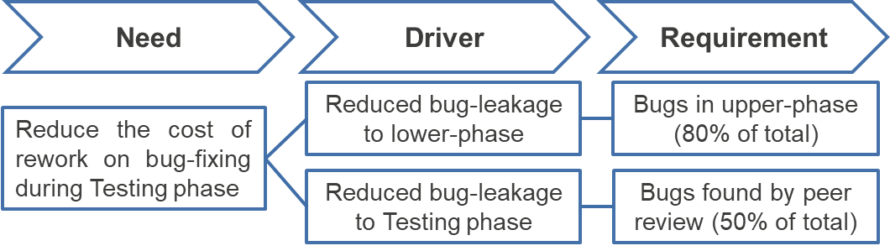
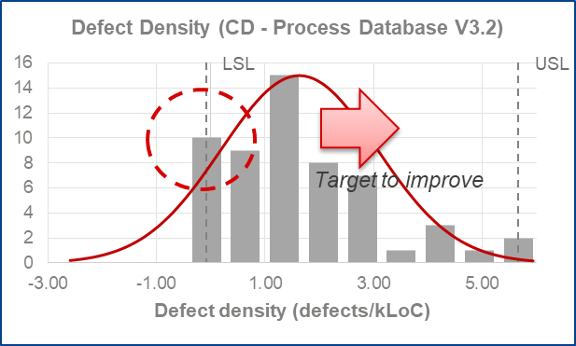
(4) Quality Control Utilizes DMAIC (Six-Sigma)
IMPROVE
CONTROL
Figure: A critical to quality (CTQ) tree (Example)
Long-run maintenance
Countermeasure
Result
DEFINE
MEASURE
ANALYZE
Cause A
RVC Process Database
Quality
Problems?
Cause B
Histogram
Max
Cause C
Data point
Build up to measure Looking in database
Point-out
…
Average
Control chart
Min

Slide 17
(5) Trending on Quality: A Common Understanding
Case 1: The good
It’s OK. Risk is just so small. And it seems the bug is in control!
It’s OK. Risk is just so small. And it seems the bug is gone!
With few data, cannot make any conclusion.
Trending line
Figure: Index chart of capability measurement (Example)
Case 2: The evil
Trending line
It’s OK. Risk is just so high. But you still be fine!
It’s OK. Risk is just extremely high. And you will be fine fired!
Case 3: The control
If we can forecast the next quality at this point, then we can against the evil.
It’s OK. Quality was critical. But we took back the control!
Judgement is made base on quality trending!

Slide 18
(6) Measurement and Analysis (MA)
After that ➔ maintenance
When you can
When you can
MEASUREment
CONTROL
IMPROVE
Then you can
Then you can
Analysis
Compare
Monitor / Tweak
Define
Target
vs.
Actual
Actual’
(next) Target’’
can come from:
Spyche (random value) ☹
Assignment (decision making) 😐
Reference (process database) ☺
Transform
Transform

Slide 19
(7) Updated MA Template for JB5001 (Aug 06, 2020)
https://renesasgroup.sharepoint.com/sites/REL-portal/dqiportal-en/SitePages/Software%20Development%20Standards.aspx

Slide 20
Measurement
Everything Project Leader or person who was assigned to handle MA needs to know…
Page 20

Slide 21
Why?
Definition of (Data) Measurement
A quantitative study in which an object or event is compared with other objects or events.
Providing information that identifies and manage risks, provides early detection and resolution of problems, and improves decision making in time to affect the business or mission outcome.
Supporting evidence-based team communication, enabling objective planning and estimating, and assessing organizational performance in an unbiased and defensible manner.
Metrics based on Measurement
Project metrics:
Project plan: original plan vs. actual progress
Project status: on time vs delay
Status of Project (Management)
Product metrics:
Determine product quality level
Identify defects ratio on each phase
Ensure product quality according to the capability
Quality of Product (Cost)
Process metrics:
Compliance with the defined process
Healthy of Process (Capability)

Slide 22
(1) Effort Management Plan and Actual
Development effort
Amount of workload (man-hour) required for implementing works such as designing, developing, testing, peer reviewing, investigating, etc.
In general, it is the total workload of whole team connecting to the main work of project to provide the valuable output.
Management effort
Amount of workload (man-hour) required for managing works such as progress management, risk/problem management, configuration management, design reviewing, etc.
In general, it is the workload counted from Project Manager, Project Leader, Configuration Auditor who are handling the management tasks on the project.
Some notes for effort management
Target process for measurement is from Requirement Development to Development Completion.
Development effort is measured in each process.
Management effort is measured in each process or accumulated for all target processes since it’s too small to compare with development effort.
Total effort of team is the sum of development effort and management effort.

Slide 23
(2) Defect Estimation-management plan and actual
Definition of defect
A defect is an issue pointed out by either reviewing or testing activities from development team or reporting by someone else, and that issue is classified as serious to impact the quality of work.
An issue is called a defect when there is a violation found comparing with previous phases or plan as intention, such as coding was incorrect comparing to detailed design or redundant code.
In most of cases, issues of coding styles such as violation of coding rule or source code format is poor to read should NOT be counted as defect since they are too small to cause an impact to total quality.
Number of defects
It is measured in each process, from FD/AD to DQ/QQ.
PP is for making the plan and confirming the intention, then an issue pointed out violates nothing and should NOT be counted as defect, unless it was an out-of-expectation defect from the base product.
Some notes on defect estimation-management
A defect is also called a bug under some contexts.
An issue is also called a problem under some contexts.
A defect is a kind of issue, but it’s classified as more serious ➔ it should be covered by both the defect management and problem management under JB5001 development process viewpoint.
A defect recorded as “found by testing” could be either defect of product or defect of test.

Slide 24
(3) Development management plan and actual
Development LOC
Not only source code, but also documents (project plan, design spec., test spec., test report) measure the scales of work (base scale, completion scale, production scale, etc.)
Re-using source
Production scale
Work products
Completion scale
New scale
New scale
New scale
Base scale
Re-use scale
(no change)
Re-use scale
Modification scale
Modification scale
Modification means the code was replaced by something else with the same meaning and context.
Restructure scale
Removal scale
Removal scale
Removal means the code was deleted and the corresponding meaning and context are non-existed.
Formula to calculate development LOC
○ Completion scale = Re-use scale + New scale + Modification scale
○ Restructure scale = Modification scale + Removal scale
○ Production scale = New scale + Restructure scale
Figure: Definition and type of development LOC

Slide 25
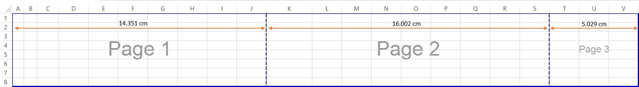
(3) Development management plan and actual
Some notes for measurement within the scope of development management
Page: number of pages at the time of printing.
Even changing on each page just a single character, the number of modified pages are still being counted as full-pages.
If 100 pages were modified just for a single character on each, then the total of pages to be recorded should be 100. It is due to a fact that a normal review process needs to scan all 100 pages to confirm the modification point one by one.
For Excel sheet file, the page-size of printing can be customized following to the cell-size and hence the number of printed pages are varying. In this case, the page-size can be determined as a rectangle with approximately size 15cm x 26.4cm (WxL).
The difference in size between pages can be acceptable if the gap is less than 2cm or it is the last page in either horizontal direction or vertical direction.

Slide 26
(3) Development management plan and actual
Some notes for measurement within the scope of development management
Source code:
Blank lines are not counted.
Comment lines are not counted.
Multi-statement is counted according to the number of statements, regardless of whether they are on the same line.
It is recommended to use a common tool for counting source code. There are 2 good tools:
Kazoeciao (http://ciao-ware.c.ooco.jp)
This tool is commonly used in various projects in Renesas Group.
SLOCCount: (https://dwheeler.com/sloccount/)
This tool is under GPL license and it can measure the value of source code in term of USD.
The line of code (LOC) is unified as C-style line of code. For other programming languages such as Assembly, C++, Java, C#, etc. the line of code can be smaller or larger for the same function points or algorithm and hence cannot be mixed when collecting the measurable data. Please take a note for a data collection to make a correct classification.

Slide 27
(3) Development management plan and actual
Some notes for measurement within the scope of development management
Number of test items: number of PASS-FAIL evaluation for test items
PASS-FAIL judgement are defined by test spec. and PCL. Each PASS-FAIL item is called as test item or test case. In some cases, the Regression Test is a combination of several test items created before to be a single judgement PASS-FAIL in PCL, then it should be counted as 1 test item only.
If the meaning and context of test spec. and PCL are not changed, no matter how much times a test item was executed, it should be counted as 1 test item only.
In test preparation, number of test items as plan value (A) can be estimated from test density base on lines of code of product, while number of test items as actual value (B) are the created test items.
In test execution, the actual amount of test items created (B) will be the plan value of execution, while number of test items executed (C) are recorded as actual value.
In real situation, (A) may or may NOT be matching with (B), and (B) may or may NOT be matching with (C). Additionally, re-executing (C) multiple times can be separated to another plan if the testing context is changed, such as testing for milestone 1, milestone 2, or platform X, platform Y.
However, JB5001 (May 2018) development process is grouping test preparation and test execution as unified test process, then (A) and (C) are used as plan and actual of test items. Now (B) is understood as matching with (C), no matter some other test cases were created but not executed.

Slide 28
(4) Peer review management plan and actual
Review measurement value
Target scale of review: development LOC of reviewed items (page, line, number)
Review duration: time spent for review (hour)
Number of reviewers: number of persons participating in review
Number of review issues: number of issues detected in review (including defects)
Number of review defects: number of defects classified from the review issues
Some note on review measurement value
If there is more than 1 kind of development LOC (such as reviewing test spec. and test items) in the same review meeting, it should separate the meeting into sub-review meetings with independent records because the review performance analysis cannot mix many kinds of development LOC.
The number of reviewers only count for whom contributing to the review process. Hence listeners are out of the counting.
There is no issue to joint the records of multiple continuous review meetings into the same one meeting if the meaning and context of meetings are still not changed (same purpose of meeting, same number of reviewers). It is because either development LOC is too large, or review duration is too long for a good concentration and it requires a long-break. However, to avoid a confusion on later analysis, it is recommended to keep each meeting within 2 hours and hence separating into multiple review records is preferable.

Slide 29
(5) Project Measurable Data Management
Challenge on data collection:
Traditional Waterfall or V-model has only one route to go: design (FD/AD, DD/UD) ➔ code (CD) ➔ test (UT, IT, ST/VT).
Flexible agile-like model repeats the design ➔ code ➔ test in many small iteration cycles.
In practical situation with a lot of requirement-changes from customer, a project development flow is customized so that it can adapt with multiple activities at the same time.
For instance, an old module is on maintenance state, a current module is on testing state, a new module is on designing state.
Jan
Jun
Dec
V-model
Module A
Design
Code
Test
Maintenance
Module B
Design
Code
Test
Agile-style
Module C
Design
Waterfall-model
Current week
Figure: V-model, Waterfall model and Agile style
Figure: Example of schedule for multiple development activities

Slide 30
Analysis
Everything Project Leader or person who was assigned to handle MA needs to know…
Page 30

Slide 31
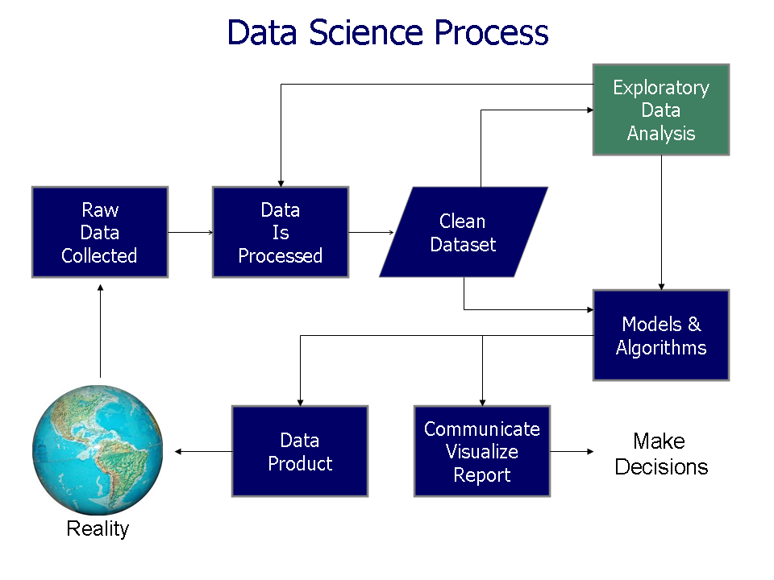
Why?
Definition of (Data) Analysis
A process for obtaining raw data and converting it into information useful for decision-making by users.
Inspecting, cleansing, transforming, and modelling data in which useful information is discovered.
Playing a role in making decisions more scientific.
Phases of analysis
Data collection: collecting raw data from many sources
Data processing: organizing data under template or format
Data cleaning: correcting incomplete, duplicated data
Exploratory data analysis: understanding the messages
Modeling and algorithms: building mathematical formulas
Data product: interfacing to external environment
Communication: reporting and making decision
Figure: Phases of analysis

Slide 32
A Simple analysis is always difficult to handle
Sometime people is confusing between:
Less bugs is better: reduce the bugs occur as prevention
More bugs is better: detect the bugs to achieve a target called “saturation”
If the project has few bugs, does it mean quality is good or bug hunting skill is poor?
ZERO
➔ It could be “not-yet found, not-yet”!!
Target
If the project has a lot of bugs, does it mean quality is poor or bug hunting skill is good?
➔ Probably “still more, yet-still more”!!
Those two approaches do NOT against each other.
They are just used in different periods: “CONTROL” vs “IMPROVE”.
Hence, using incorrect approach in one period will make the analysis be more difficult.

Slide 33
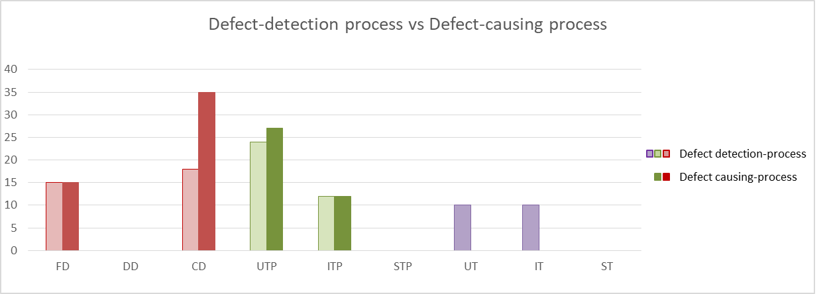
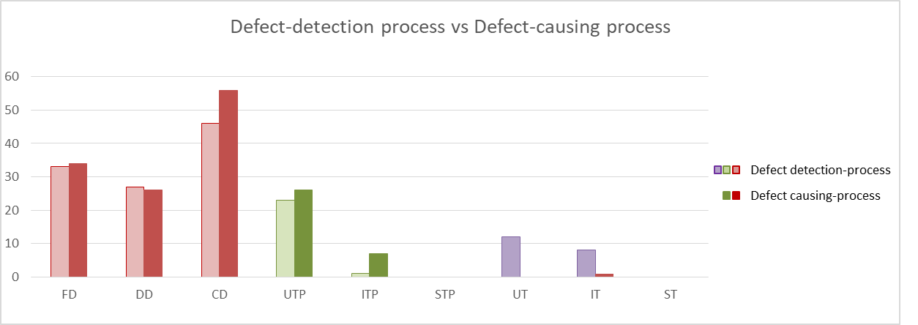
Analysis (Example #1)
BEFORE IMPROVEMENT
Question #1: Why DD has no defect but other phases have defects?
Analysis #1: since other phases have a lot of defects, the chance for high quality DD (make no defect) is low ➔ it means DD has an issue of peer review (not enough review or review is poor).
Self-detecting bugs in CD is poor!
Causing-phase is confirmed as CD
Question #2: Why UT and IT found defects?
Analysis #2.1: defect classification should be handled to detect causing-phase.
Analysis #2.2: causing-phase is confirmed as CD which means self-detecting bugs in CD is poor and leaking bugs to testing phase.
AFTER IMPROVEMENT
The target of analysis is NOT to reduce the bugs as improvement.
The target of analysis is to confirm the logic of work as it should happen like the planning and estimation. The improvement then will be handled by other activities.
Self-detecting bugs is improved!
Quality is OK!

Slide 34
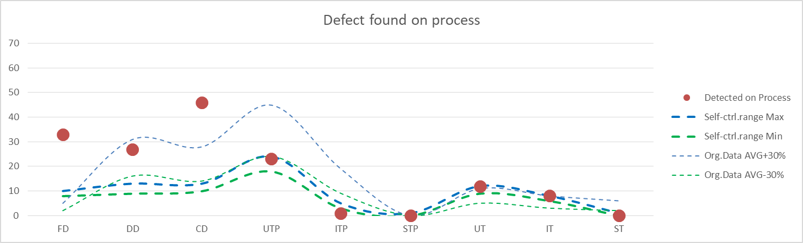
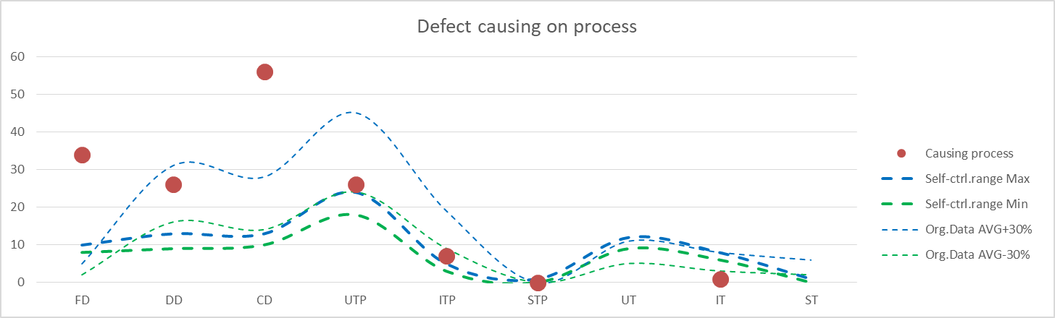
Analysis (Example #2)
Question #1: Why self-control range is lower than the average of Process Database?
Analysis #1.1: Does it mean the development skill is so good so that the self control range is lower? ➔ This analysis can be accepted if the skill evaluation is clear.
Analysis #1.2: Following to time, the actual result is higher than self-control range so that the analysis #1.1 is incorrect and rejected. Then the plan should be re-estimated but the project didn’t do it ➔ recommend to setup another control range for better monitoring.
Question #2: Why actual value is higher than expectation?
Analysis #2.1: Designing skill has a problem. If so, later phases such as DD and CD should be monitored strictly.
Analysis #2.2: The result of DD and CD are still higher than expectation. However, we can NOT make any conclusion here without other analysis charts. From this point, we need to analyze more the peer review performance to understand whether the bugs found can be “saturated” under low-skill of development.

Slide 35
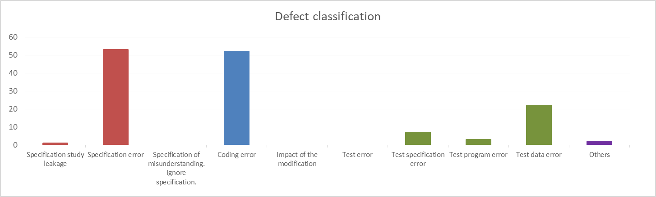
Analysis (Example #3)
(from Global SEPG template)
Question #1: What is the common mistake to make a defect?
Analysis #1: Specification error and Coding error are two common mistakes. Following to the project explanation, the Specification error occurred during design implementation while the Coding error occurred during coding. Then it seems quite possible to take some controls to reduce those mistakes. How to improve it? ➔ We need to use other analysis charts to confirm the peer review performance and then defining the improvement plan.

Slide 36
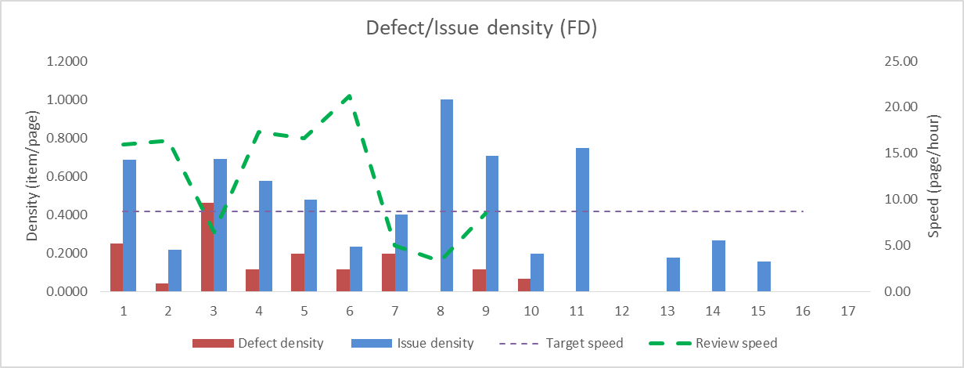
Analysis (Example #4)
(from JB5001 May 2018 template)
Note #1: the review speed, issue density and review engagement rate vary between peer reviews. It is due to a fact that the scope of reviews and the number of issues pointed out are NOT the same per review. Hence, it’s quite difficult to analyze the peer review performance individually. In fact, only the average values of all reviews will be the target of simple analysis.
Note #2: the advance analysis will confirm the detail quality status by checking the trend and relationship of series of peer reviews as the below chart.
Analysis: Trending of reviews 1~7 are good. The number of defects/issues reduced over time and review speed is NOT far away the target which implied a stable reviewing and quality is saturated. However, reviews 8~11 and 13~17 broke the trend with more issues and defects found. Possible reason could be new features were designed and had issues comparing with previous ones ➔ need to confirm with project in detail. In general, the designing skill is poor but the reviewing skill is good to guarantee the pointing ➔ fixing issues before next phases. Quality is OK.

Slide 37
Analysis (Example #5)
(from JB5001 Apr 2017 template)
Analysis: Actual result of FD is larger than the plan and modified values. It means that the project has issue about estimation and need to lookback again the plan of later phases. However, it seems that they were still confident on their own estimation, so the adjustments were meaningless comparing to the actual result. The risk on losing the control of quality is high.
Case 2: The evil
Trending line
It’s OK. Risk is just so high. But you still be fine!
It’s OK. Risk is just extremely high. And you will be fine fired!

Slide 38
Analysis (Example #6)
(from JB5001 May 2018 template)
Analysis #1: Planning for production scale is quite poor so the number of expected test cases for UT are incorrect. Perhaps the project member misunderstood the concept of production scale and then make an incorrect plan.
Analysis #2: The actual number of created test items are higher than the expectation (test density is higher). Higher test density is usually better since there are more test cases to confirm the logic of code. However, the cost of good quality will be increased for both the test preparation, test execution and maintenance phases so the project needs to consider again for the budget plan.
Analysis #3: IT, however, has lower test density than the expectation and it will add a risk to IT phase. There could be NOT enough number of test cases to confirm integration system, and then potential bugs could be leaked outside. Since the project has no plan with ST, then IT is the final gate and the risk of bug-leakage is quite high.

Slide 39
Analysis
Notes
Example #1 ~ #6 provide only general analysis when 1st looking at the project data.
02 of them praised for the improvement of project and concluded that quality is OK.
04 remaining put concerns about the risk of quality and potential of bug-leakage.
Do you believe that all 06 examples are from the same project in the same period?
Project only handled 02 analyses that said, “quality is OK”, then they did nothing more.
04 concerns were NOT analyzed during the project life. Instead, they were confirmed lately as lookback after the project received the bug-leakage claim report from REL.
Don’t look at only 01 analysis. If it said, “everything is good”, other analyses may reject it soon.
Analysis is used to reduce the risk of quality control and make the future estimation for project if trending is clear.
If any analysis is showing that the risk is high, then an action needs to be taken immediately.
If trending is unclear, then any estimation number is nothing more than a random number.
To support for the analysis, there are several tools called Quantitative Quality Control (QQC) indicators are used on the project measurable data. Some of common indicators are introduced later in this material.

Slide 40
Defect Management
Everything Project Leader and Project Manager need to know…
Page 40

Slide 41
Defect detection
Definition:
In-process defect: a defect which was detected within the development process.
Design defect: a defect which was detected after Design Qualification process (bug-after-release).
Number of (In-process) defects are counted from the Functional Design process to the Design Qualification process.
Two methods of defect detection: by review and by testing.
But defect is sometime detected and claimed by customer ➔ extremely serious, even though it is still In-process defect.
Test execution can detect defects of product and testing itself ➔ need to be classified before taking an analysis.

Slide 42
Defect detection
How to count In-process defect:
For the In-process defect, count the phenomenon of 1 defect as 1 case.
Even if in the case to solve that in-process defect, many parts and many deliverables need to be handled, still count it as 1 defect only.
Even if the unresolved defect is pointed out again by reviews or by other test cases (confirming the root cause is same), still count it as 1 defect only.
However, right after the solution has been taken to resolve the defect (result is PASS by review or by testing), if it is pointed out again as in-process defect due to insufficient solution (PASS is confirmed as incorrect result), count it as the new In-process defect.
In the case the defect was found on re-used part in the same process-meaning (like re-use source code and found defect in Coding phase), count it as 1 defect but for re-used part.
How to count Design defect:
Refer to the section “Quality objectives: bug-after-release”

Slide 43
Defect detection
Issues (findings) by peer review ➔ classify as defects if:
For specification (FD/AD, DD/UD, UT, IT, ST/VT):
Item that do NOT satisfy the requirement (request), deliverables requirement (commitment).
Item that description is ambiguous and by be misunderstood.
Item that may create defects in deliverables of the next process.
Among the typo or item that may create (logic) defects, such as unit mistake (usec → msec), incorrect boundary condition (>5 → <5), incorrect register setting (bit7 → bit8).
For source code: anything that is NOT matching with detail design specification
Mistake of description of variable type
Mistake of setting value of register
Mistake of condition of statement
Redundant code that has no meaning within the scope of design

Slide 44
Defect Management: cause and classification
Process detecting defect:
It is used to record the phase that detecting defect.
The phases that have activity to detect defects: PP, RD, FD/AD, DD/UD, CD, UT, IT, ST/VT, Other.
Note #1: “Other” is used when the defect is detected outside the process or outside the normal activity as intention (plan). It is used to understand the possibility of out-of-expectation defects.
Defect found in DQ/QQ
Design defect found after a release (a release requires either formal or informal testing).
Defect found by unplanned activities such as a report from 3rd party or project members found it accidentally by reading the source code for relaxing when waiting a result of long test execution.
Note #2: it is assuming that a defect caused during design-code-test which means starting to count from the phase FD/AD until DQ/QQ. However, preparing/reviewing in PP and RD in some cases can help to detect defects of base product or re-usable product or reference product that were developed outside the project.
Even it has an impact to the quality of current product, it is treated as a risk under risk management rather than a defect under defect management.
The recording, monitoring and control in this case can be taken as the project decision, however analyzing for development capability of project can be skipped since they are outside the project.

Slide 45
Defect Management: cause and classification
Process causing defect:
It is used to record the phase that causing defect.
The phases that have activity to cause defects: FD/AD, DD/UD, CD, UT, IT, ST/VT, Other.
Note #3: “Other” is used when the defect is confirmed outside the current product, such as from base product, re-usable product, reference product, dependency product, or hardware platform. Otherwise, the phase from FD/AD to ST/VT should be clearly specified.
Note #4: in some recording templates such as JB5001, phases PP and RD are included but not used, since PP and RD has no criteria to violate and hence cannot provide defect.

Slide 46
Defect Management: cause and classification
Cause of defect (from Global SPEG guideline)
Types | Explanation
Specification study leakage | Following to the specification but it was leaking or missing (not enough)
Specification missing error | Following to the specification but it was missing (not existed)
Specification description error | Specification was confirmed as incorrect
Coding error | Following to the specification but coding was incorrect
Test specification error | Error in the test specification and checklists (PCL)
Test error | Error in test method (version, deployment, execution)
Test program error | Error in test program (test env., test script, automation env.)
Test data error | Error in the data (input data, configuration data)
Insufficient correct | Modifying the LOC (source code, or page) and causing another issue
Other | Other than above

Slide 47
Defect Management: cause and classification
Cause of defect (from JB5001, May 2018 guideline)
Types | Explanation
Specification study leakage | Following to the specification but it was leaking or missing (not enough)
Specification error | Specification was confirmed as incorrect
Specification of misunderstanding | Following to the specification but the understanding was incorrect
Ignore specification | NOT to study the specification before implementing
Coding error | Following to the specification but coding was incorrect
Impact of the modification | Modifying the LOC (source code, or page) and causing another issue
Test error | Error in test method (version, deployment, execution)
Test specification error | Error in the test specification and checklists (PCL)
Test program error | Error in test program (test env., test script, automation env.)
Test data error | Error in the data (input data, configuration data)
Other | Other than above

Slide 48
Defect Management: Reference from REL/ABU
In-process defect
Defect caused by design that does NOT satisfy product specifications of software and board, customer’s request (function, and performance, characteristics, etc.) detected before DQ/QQ execution.
Inadequacy of sales document detected after providing it outside the Renesas.
Design defect
Defect caused by design that does NOT satisfy product specification of software and board, customer’s request (function, and performance, characteristics, etc.) detected after DQ/QQ execution.
Inadequacy of sales document detected after providing it outside the company.
6 ranks of classification: (1) serious quality incident, (2) major quality incident, (3) quality incident, (4) quality issue category A, (5) quality issue category B, (6) quality issue category C.
Design defect requires “Konpon cause analysis” and “5-Why analysis”.
Customer claim
Quality problems of software and board that require quality assurance found by customer.
Equivalent to (RVC) in-process defects
Equivalent to (RVC) serious bugs required 5-Why analysis
Equivalent to (RVC) Bug-after-release

Slide 49
Defect Management: Reference from REL/BBU
Quite the same viewpoint…
 |  |  | Person discovered defects
 |  |  | In-house (REL group) |  |  |  | Outside of REL
 |  |  | Developing in charge division |  | Not-in charge developing division |  | Distributor (tokuyakuten) | Customer
 |  |  | Defects of newly changed parts | Defects of reused parts | Discovered during other development | Discovered at outside of development
In developing | Plan phase |  | N/A | N/A | N/A | N/A | N/A | N/A
 | Design phase | Before design certification | Defects in development process | Design defects | N/A | N/A | N/A | N/A
 |  | After design certification | Design defects | Design defects | Design defects | Design defects | Design defects | N/A
 | Qualifi-cation phase | After qualification | Design defects | Design defects | Design defects | Design defects | Design defects | N/A
 |  | After official release | Design defects | Design defects | Design defects | Design defects | Design defects | Customer complaint
After development completed |  |  | Design defects | Design defects | Design defects | Design defects | Design defects | Customer complaint
Equivalent to (RVC) in-process defects
Equivalent to (RVC) serious bugs required 5-why analysis
Equivalent to (RVC) Bug-after-release

Slide 50
Defect Management: Reference from REL/BBU
Quite the same viewpoint… but less raking on low-level issues
Rank | Category | Design certification date | Aras registration | Case (5 why) analysis
Serious Quality Incident | ー | ー | Required | Must
Major Quality Incident | ー | ー | Required | Must
Quality Incident | A | Within past 3 years | Required | Must
 | B | Until 3 years ago | Required | Must
Quality Issue | ー | ー | Option | Option

Slide 51
Quantitative Quality Control (QQC) Indicators
Everything Project Leader and Project Manager need to know…
Page 51

Slide 52
QQC Indicators – an overview
Indicator
Measuring and evaluating the current state or level of something.
Quantitative Quality Indicator is to measure and evaluate the current state or level of product quality by using the quantitative methods.
Some notes on QQC indicators
There is NO perfect indicator to measure and evaluate the product quality precisely.
The indicator is used for measuring and evaluating, and hence it tells the lie-story sometime.
At the beginning, someone makes the output, then an indicator is used to measure and evaluate the quality of output. Under the analysis of indicator, good things and bad things are pointed out to take lesson-learn.
Later someone refers to the lesson-learn and realizes that just satisfying the indicator analysis and the judgement on quality will only tell good things. However, in most of cases the result may not be good as expectation but a kind of cheating or “too-beautiful-to-be-real”.
It does NOT mean the indicator is bad. It just means that everyone tries to follow it and “drives” the result to fit the analysis indicator and makes a nice report and following to that serious issue is hidden on the background.

Slide 53
QQC Indicators – an overview
Indicator
Measuring and evaluating the current state or level of something.
Quantitative Quality Indicator is to measure and evaluate the current state or level of product quality by using the quantitative methods.
Some notes on QQC indicators
There is NO perfect indicator to measure and evaluate the product quality precisely.
An indicator is used for a specific purpose and hence it only sees a corner of general issue.
Indicator is similar to eyes watching one side of cycle.
It recognizes the cycle has green color but does NOT know another side has purple color.
Indicator tells the result is good does NOT mean the total result is also good. It’s necessary to confirm many other indicators to make the final judgement.
You should NOT rely only a single indicator!!!

Slide 54
QQC Indicators – Improvement Points
1. Data collection
Action: Collect quality control measurable data
Requirement: Intermediate data by monthly
Improvement points in RVC ESW until 18-2H:
Monitoring peer review performance
Defining QQC indicators for monitoring and control
2. Analysis
Action: Compare between actual measurable data and target/reference data
Requirement: Control chart with acceptance range to detect abnormal case
3. Judgement
Action: Report the quality judgement to the project and manager
Requirement: Ability to continue development and to properly describe the quality issue
Target area to improve!!
4. Diagnostics
Action: Handle the diagnostics by project to gather the practical experience on workflow
Requirement: Experience on diagnostics
5. Improvement
Action: Apply countermeasures
Requirement: Experience on diagnostics
Figure: Measurement and analysis (MA) in project integrating with quantitative quality control
Figure: Process map for QQC monitoring and control
Peer review performance
Coding performance
Testing performance
QQC Indicators
review engagement
test case density per line of code
production efficiency
review speed
source code reusable rate
defect rate per line of code
review defect/issue density
re-fixing rate
defect rate per test case

Slide 55
QQC Indicators – How RVC achieved good Result
Early achievement on the capability analysis of defect density of Peer Review: ZERO-density is reduced!
Before
Target to improve
Target to improve
Target to improve
Figure: Capability analysis of defect density on Peer Review (FD, DD, and CD – Process Database V3.2)
After
Figure: Capability analysis of defect density on Peer Review (FD, DD, and CD – Process Database V4.0)

Slide 56
QQC Indicators – How RVC achieved good Result
Early achievement on the defect distribution: lower rate on Testing phase!
Note: PS - Purchase Spec.
Before
PS count: 57
PS count: 66
PS count: 88
52.16%
52.06%
60.28%
47.94%
39.4%
39.72%
47.84%
41.24%
22.11%
Figure: Defects distribution among development phases – a survey on terms 15S~16S – CMMI appraisal
PS count: 100
PS count: 104
PS count: 90
PS count: 99
50.17%
74.33%
79.61%
74.43%
25.57%
49.83%
25.67%
17.51%
20.39%
8.63%
6.52%
4.27%
Figure: Defects distribution among development phases – a survey from terms 17-1H and 18-2H. (CMMI with JB5001)
After

Slide 57
QQC Indicators – A collection of Tools
Note: PS - Purchase Spec
PS count: 57
PS count: 99
60.28%
74.43%
25.57%
39.72%
22.11%
4.27%
Figure: Defects distribution among development phases – a survey from terms 15S to 16S. 15S – CMMI appraisal; 16K~16S – CMMI trial process
Figure: Defects distribution among development phases – a survey from terms 17-1H and 18-2H (CMMI with JB5001)
To achieve this result, various indicators were used to cross-confirm the analysis of each others, then making the final judgement whether the total quality is good or bad.
Peer review performance
Coding performance
Testing performance
QQC Indicators
review engagement
test case density per line of code
production efficiency
review speed
source code reusable rate
defect rate per line of code
review defect/issue density
re-fixing rate
defect rate per test case

Slide 58
(1) QQC Indicators – A collection of Tools
Peer review performance
Peer review performance
Coding performance
Testing performance
QQC Indicators
review engagement
test case density per line of code
production efficiency
review speed
source code reusable rate
defect rate per line of code
review defect/issue density
re-fixing rate
defect rate per test case

Slide 59
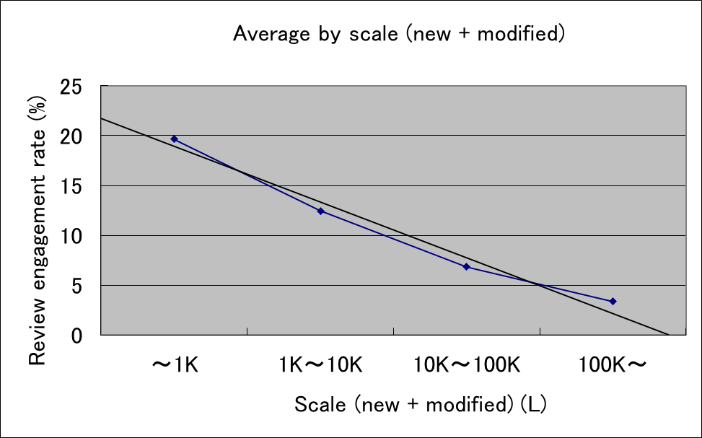
(1-1) QQC Indicators – Peer review performance
Review Engagement
Small scale of review has higher review engagement rate.
Large scale of review has slower review engagement rate.
It’s not necessary to have too much review since the cost of good quality will be increased accordingly.
If the scale of review can be controllable and fixed per review, then the review engagement is saturated.
10 peer reviews, each review has a target 1,000 LoC
vs.
1 peer review that has a target 10,000 LoC
Which one is better? ➔ Depending on the review duration and scope.
Tips:
Best time for review : morning session with flesh-mind
Review duration : ~1.5 hours for good concentration
Review scope : independent and meaningful scope per time
Participants : only related members (2~3 members)
How often? : regularly instead of waiting until the end of phase
How much? : 5, 10, 20, 100 times, etc. (but less than 3 is too few)
Figure: Code review engagement rate comparing with scale of review (from REL report)
Y ＝ -5.446*X + 24.19 ＝ -5.446*(LOG(L)-1.5) + 24.19

Slide 60
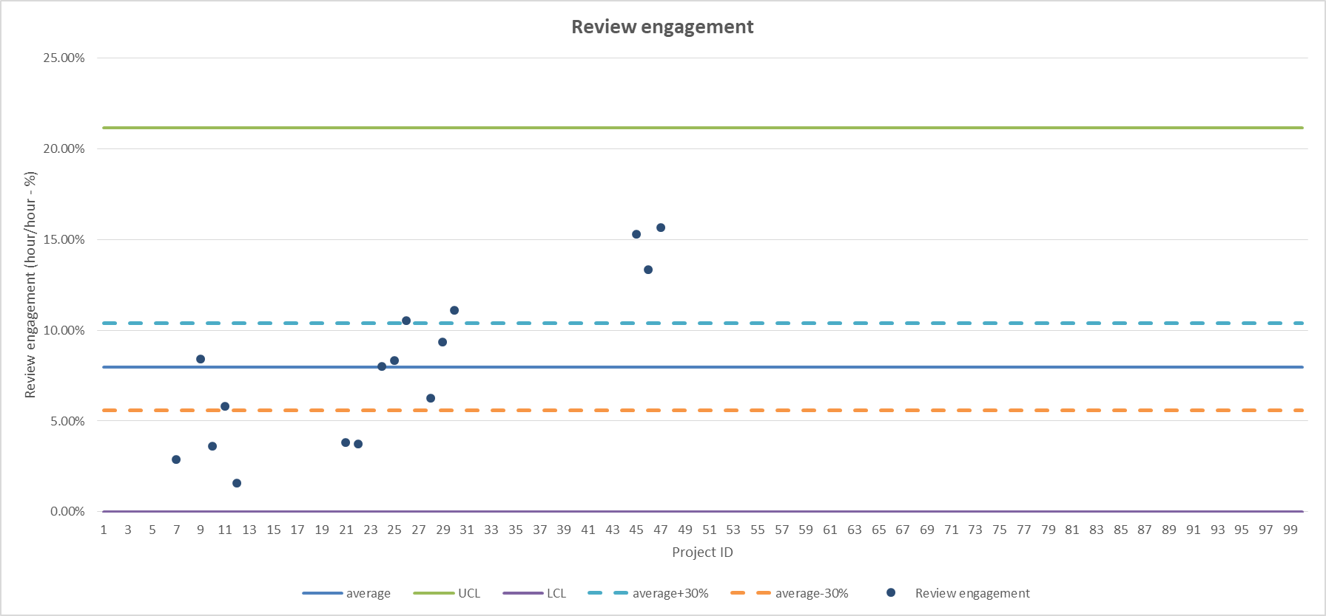
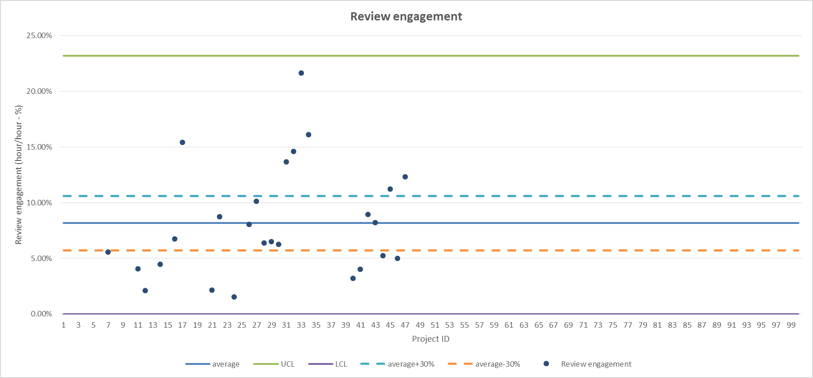
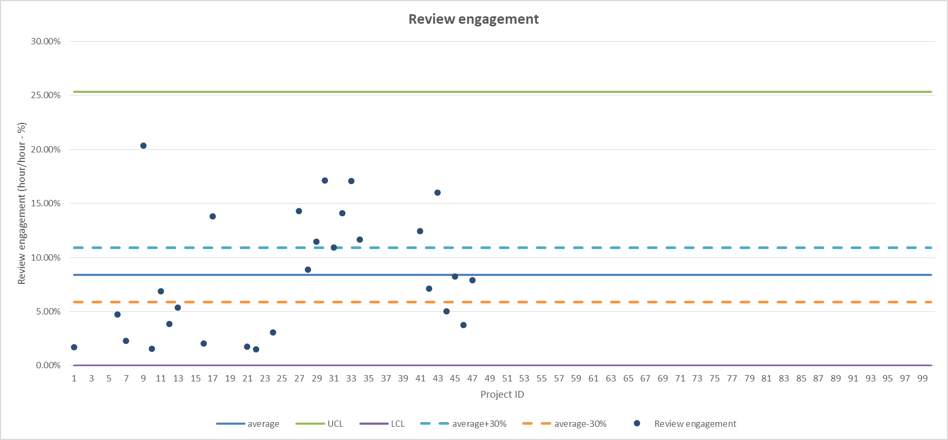
(1-2) QQC Indicators – Peer review performance
Review Engagement
Formula: Review engagement rate = peer review effort / total effort
Peer review effort = Review duration (hour) x number of reviewers + total review time on desk (hour)
Total effort = effort to implement the phase (hour)
When the process completes: effort is counted within that process.
At DQ/QQ process: effort is counted from Project Planning to System Test.
Average | 7.98%
Standard deviation | 4.38%
UCL | 21.13%
LCL | 0.00%
Average +30% | 10.38%
Average -30% | 5.59%
Average | 8.16%
Standard deviation | 5.01%
UCL | 23.18%
LCL | 0.00%
Average +30% | 10.61%
Average -30% | 5.71%
Average | 8.39%
Standard deviation | 5.65%
UCL | 25.34%
LCL | 0.00%
Average +30% | 10.91%
Average -30% | 5.87%
FD/AD
DD/UD
CD
This is the control chart of review engagement rate from RVC Process Database V4.1
From the Process Database V4.1, it’s recommended to set the target review engagement rate at 8% (3.2 hours per every 40 working-hours) for design-coding!

Slide 61
(1-3) QQC Indicators – Peer review performance
Example
Figure: Peer review performance analysis (Example)
Review Speed
How fast the review meeting is being handled.
Formula: Review speed = target review scale / review duration
Review Issue Density
Formula: Review issue density = number of review issue / target review scale
Review Defect Density
Formula: Review defect density = number of review defect / target review scale

Slide 62
(1-4) QQC Indicators – Peer review performance
Some notes on review speed
For a simple analysis, when a peer review completed, compare then analyze target values vs performance values
Review speed is fast ➔ predicting poor peer review
Review speed is slow ➔ predicting low review capability of participants
Combining with review issue density to predict the quality of product
Example
Figure: Peer review performance analysis (Example)

Slide 63
(1-5) QQC Indicators – Peer review performance
Some notes on review issue/defect density
For a simple analysis, when a peer review completed, compare then analyze target values vs performance values
Actual value > threshold ➔ predicting bad quality
Actual value < threshold ➔ predicting (1) inappropriate reviewing method, or (2) good quality
Actual value < threshold, and review speed is slow ➔ predicting (1) inappropriate reviewing method, or (2) good quality
Actual value < threshold, and review speed is fast ➔ predicting bad quality
Actual value > threshold, and review speed is fast ➔ predicting bad quality
Actual value > threshold, and review speed is slow ➔ predicting (1) inappropriate reviewing method, or (2) bad quality
Example
Figure: Peer review performance analysis (Example)

Slide 64
(1-6) QQC Indicators – Peer review performance
However, analyzing peer review performance is NOT so easy…
We may NOT predict exactly how many defects can be detected before actually handling a review and performing a test/check on output work. It’s also impacted from low-skill participants may NOT detect anything while high-skill participants may point-out a lot of issues during a review.
Moreover, reference from Process Database sometime does NOT help to analyze a particular review, since early reviews may detect a lot of issues while later reviews on the same items may only detect fewer or nothing.
Example
Figure: Peer review performance analysis (Example)

Slide 65
(1-7) QQC Indicators – Peer review performance
A series of peer review over time may show how good the conducted peer reviews are:
Why later reviews on the same module still consume a huge effort?
Why later reviews on the same module still detect a lot of issues/defects?
With a controllable review speed, actual issue/defect density is more than plan value means that quality of work is lower than expectation. If the actual density is less than plan value, it means that quality of work is higher. However, such kind of analysis is NOT always accuracy without monitoring the trend of peer review performance.
Example
Figure: Peer review performance analysis (Example)
Expected a peer review chart
Faster speed as gaining more experience
Lower density as increasing capability
Figure: Peer review performance analysis (Expectation)

Slide 66
(1-8) QQC Indicators – Peer review performance
Peer review performance under the context of review engagement rate
Lower review engagement rate may only have a little chance to detect issue.
Higher review issue/defect density may NOT prove the great skill of reviewing and guarantee all issues pointed out. In fact, it’s adding more risks on the quality of target product.
Expectation is detecting 100 bugs but detected 150 bugs. Hey!, so much bugs detected then it means 10 more bugs may still being hidden somewhere ➔ It’s over-detecting!!!
 | Quality situation | Evaluation example
⑤ | No problem | Quality is good
⑥ |  | It is necessary to confirm the review method and member.
⑧ | Possibility of good quality | It is necessary to confirm the review method, member and leak.
⑨ |  | Efficiency is poor, it is necessary to confirm the review method, member and leak.
② | Possibility of poor quality | Due to poor design, it is necessary to confirm the failure of the previous process design and insufficient review.
③ |  | Due to poor design, it is necessary to confirm the failure of the previous process design and insufficient review.
① |  | Review is insufficient, it is necessary to confirm the review method, member and leak.
④ |  | Due to lack of review, quality defects and confirmation of design and review are necessary.
⑦ | Not a situation to judge quality | Due to lack of review, there is a possibility that it may be pointed out by additional review.
① | ② | ③
④ | ⑤ | ⑥
⑦ | ⑧ | ⑨
Review issue density
Review engagement rate
Figure: Judgement matrix on peer review analysis

Slide 67
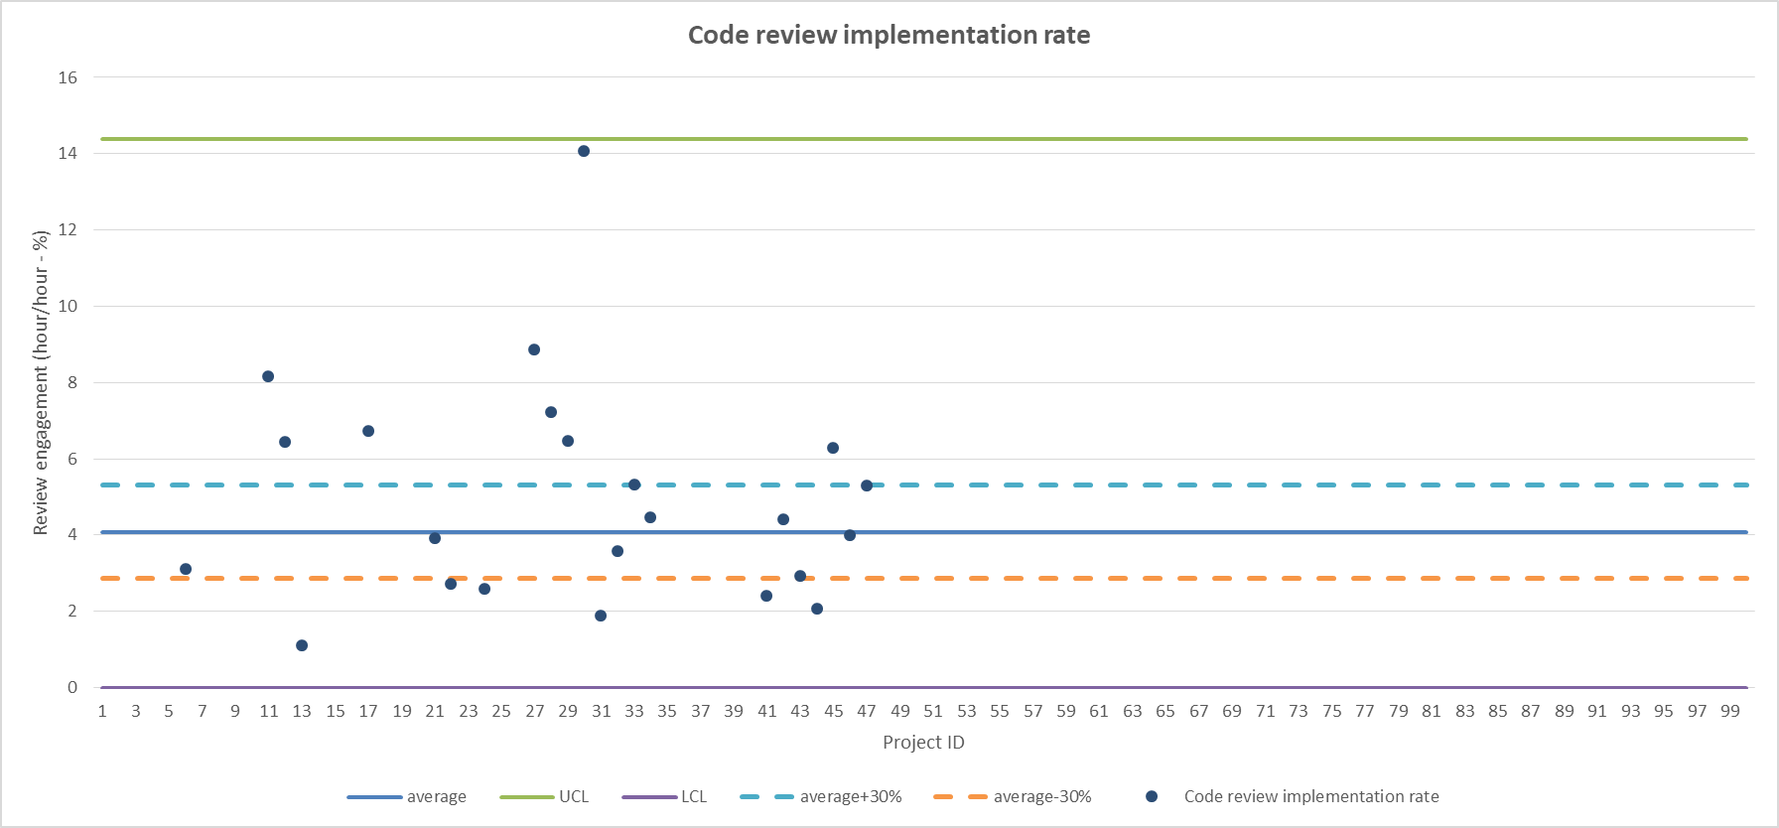
(1-9) QQC Indicators – Code Review Implementation Rate
Peer review performance ➔ code review implementation rate
The code review implementation rate is one of QQC indicators newly added by REL to the KPI (see more in the later section KPI management)
Unlike the review engagement rate that is set as management indicator (to achieve the target ➔ fail the target means fail the indicator), the code review implementation rate is set as monitor indicator (to analyze the gap between plan and actual ➔ fail the plan requires an analysis and explanation)
Formula: Code review implementation rate = peer review effort in CD / production scale
Average | 4.07
Standard deviation | 3.43
UCL | 14.37
LCL | 0
Average +30% | 5.3
Average -30% | 2.85
CD

Slide 68
(2) QQC Indicators – A collection of Tools
Coding performance
Peer review performance
Coding performance
Testing performance
QQC Indicators
review engagement
test case density per line of code
production efficiency
review speed
source code reusable rate
defect rate per line of code
review defect/issue density
re-fixing rate
defect rate per test case

Slide 69
(2-1) QQC Indicators – Coding performance
Production Efficiency
It is used to measure the cost of implementation in term of working effort (hour).
However, it just gives a general idea about the implementation cost since it must be analyzed together with analyzing the scale complexity and skill level.
Sometime the higher complexity code may have smaller amount of code lines and hence Production efficiency could be low as a result. However, without understanding the skill level of developers, the analysis could be incorrect.
Formula: Production efficiency = Scale / Effort (hour)
For DD, Scale is number of document pages, which means efficiency on making design document.
For CD, Scale is Production scale (kLoC), which means efficiency on coding product.
For UT, Scale is Production scale (kLoC), which means efficiency on testing product code.
For IT, Scale is Completion scale (kLoC), which means efficiency on testing product code.
At Software design qualification, effort is the total effort of all phases.

Slide 70
(2-2) QQC Indicators – Coding performance
Source Code Reusable Rate
It is used to understand how much source code are re-used for the current development.
When analyzing the defect density, the reusable rate can help to explain if the bugs are confirmed causing from the reusable code (adding a risk to monitor and maintain the quality of reusable code).
Formula: Source code reusable rate = Reusable rate (kLoC) / Completion scale (kLoC)

Slide 71
(2-3) QQC Indicators – Coding performance
Re-fixing Rate
It is also the “defect reopen ratio” to measure the failure of fixing defects that increasing cost of rework.
Formula: Re-fixing rate = Number of re-fixing bugs / Total number of bugs
The re-fixing rate is measured for each phase, then number of re-fixing bugs and total number of bugs are count only for causing bugs of that phase, here is the CD phase.

Slide 72
(3) QQC Indicators – A collection of Tools
Testing performance
Peer review performance
Coding performance
Testing performance
QQC Indicators
review engagement
test case density per line of code
production efficiency
review speed
source code reusable rate
defect rate per line of code
review defect/issue density
re-fixing rate
defect rate per test case

Slide 73
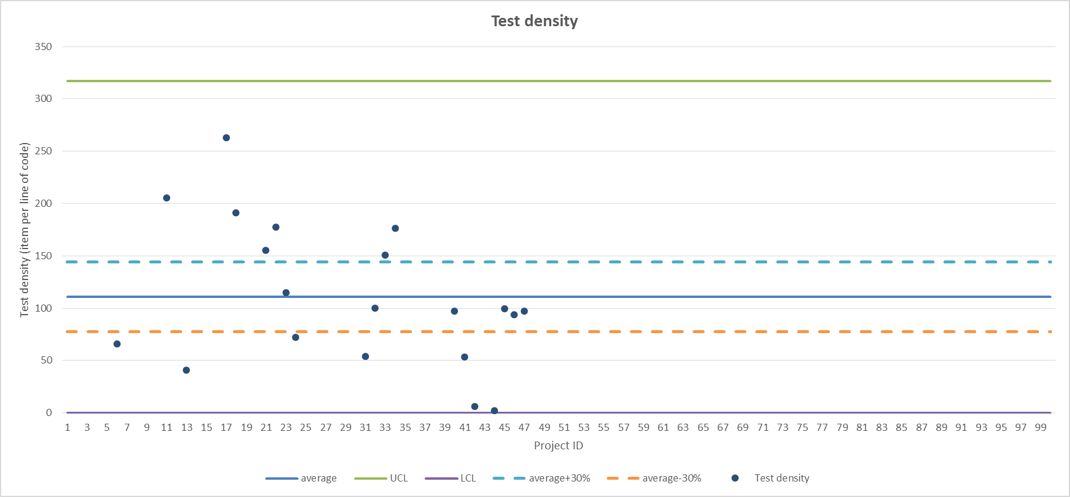
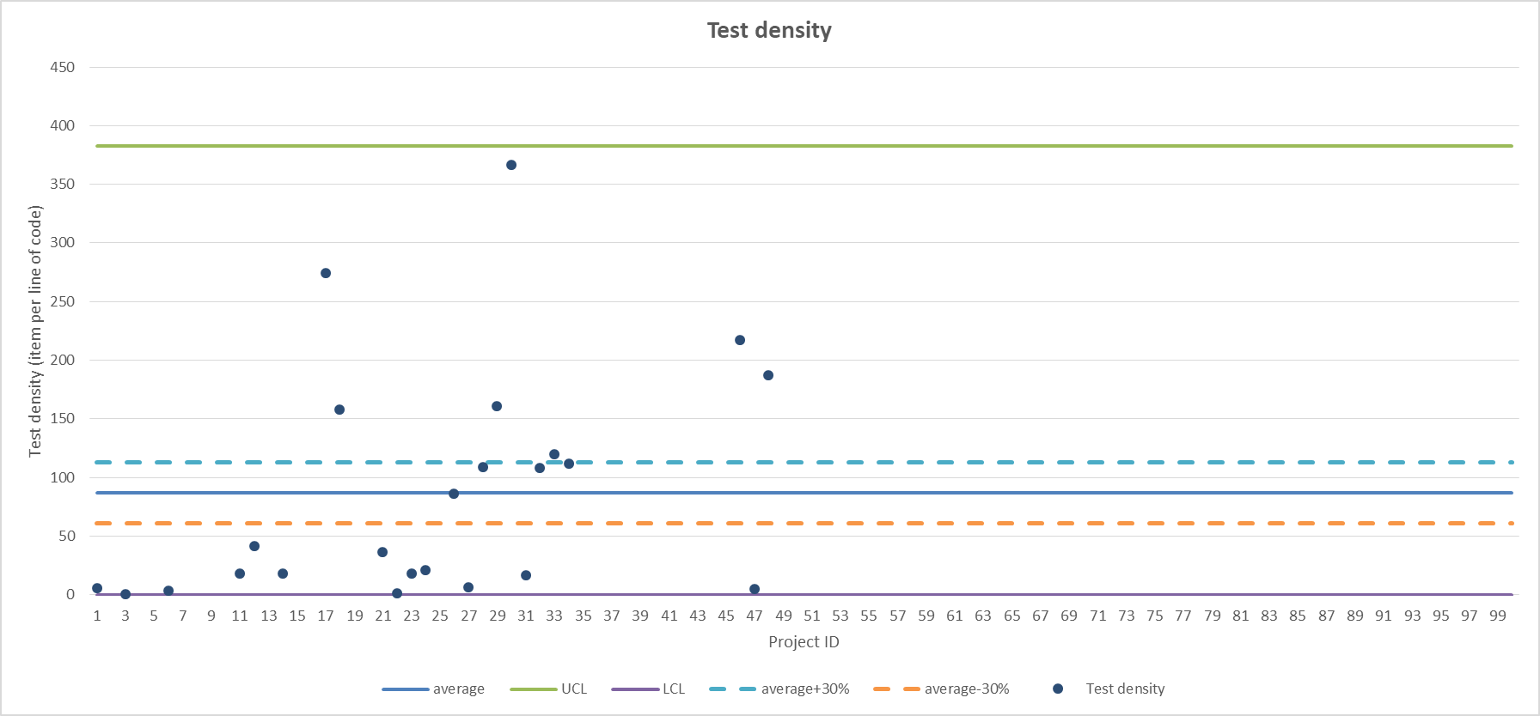
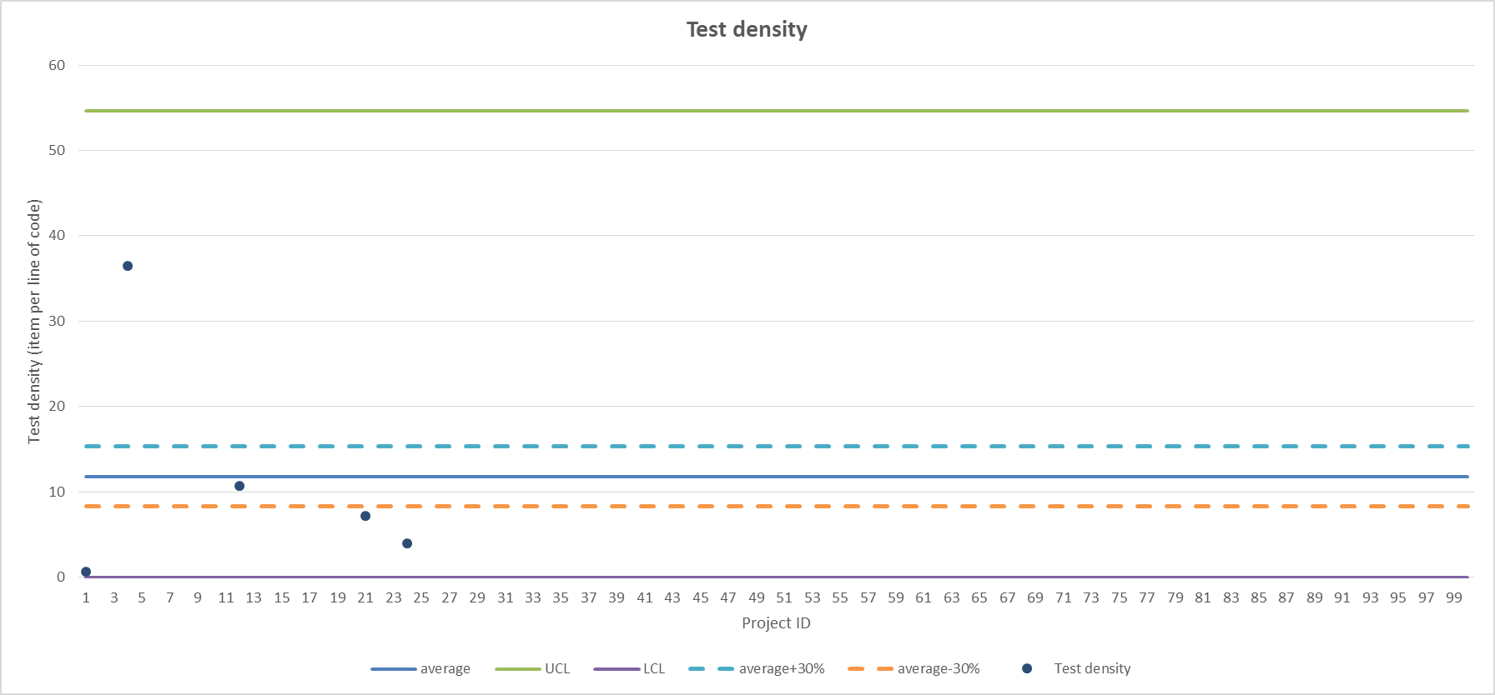
(3-1) QQC Indicators – Testing performance
Test Case Density per Production Line of Code
Formula: Test case density = Number of test items / Source code scale
For UT: source code scale is Production scale of product (kLoC)
For IT: source code scale is Completion scale of product (kLoC)
For ST: there is no mention, but a recommendation is to use Completion scale of product (kLoC)
Average | 110.8
Standard deviation | 68.65
UCL | 316.76
LCL | 0
Average +30% | 144.04
Average -30% | 77.56
Average | 86.99
Standard deviation | 98.45
UCL | 382.36
LCL | 0
Average +30% | 113.09
Average -30% | 60.89
Average | 11.81
Standard deviation | 14.28
UCL | 54.67
LCL | 0
Average +30% | 15.35
Average -30% | 8.26
UTP
ITP
STP/VTP
This is the control chart of review engagement rate from RVC Process Database V4.1
From the Process Database V4.1, it’s recommended to set the target test case density at 80~150 (for UT) and 60~120 (for IT)!

Slide 74
(3-2) QQC Indicators – Testing performance
Defect Rate per Production Line of Code
It is used to measure the quality of Production line of code in term of number of defects found.
Formula: Defect rate per line of code = Number of defects caused by coding / Production scale
Defects need to be classified the causing-phase, and then count only for CD phase.
Production scale is measured in term of kilo line of code (kLoC).
In real situation, trending of defect rate among various milestones may NOT have any meaning. It is due to a fact that the scope of work on one particular milestone could be a maintenance of previous coding (has less defects ➔ lower defect rate), or a new feature development (new experiment and hence new bugs ➔ higher defect rate).
In real situation where multiple releases or continuous development is applied, the scope of coding is changed following to each milestone and hence the Production line of code needs to be separated between them (maintenance milestone may need smaller line of code comparing with new development milestone), and then the defect rate will be calculated separately.

Slide 75
(3-3) QQC Indicators – Testing performance
Defect Rate per Test Case
It is used to measure both the test case effectiveness and bug finding rate by test.
Formula: Defect rate (per test case) = Number of defects detected by test / Number of test case executed
In the real situation, the test cases can be re-executed many times and hence they should be count as one time execution if the testing context is still unchanged.
In the real situation where multiple-releases or continuous development is applied, the testing context will be changed following to each milestone and hence defect rate will be calculated separately. Moreover, it’s being expected that later test executions will find less bugs than previous ones so that the target defect rate needs to be reduced timely as production code is more reliable and stable.

Slide 76
QQC Under Quality Management System
Everything Project Manager needs to know…
Page 76

Slide 77
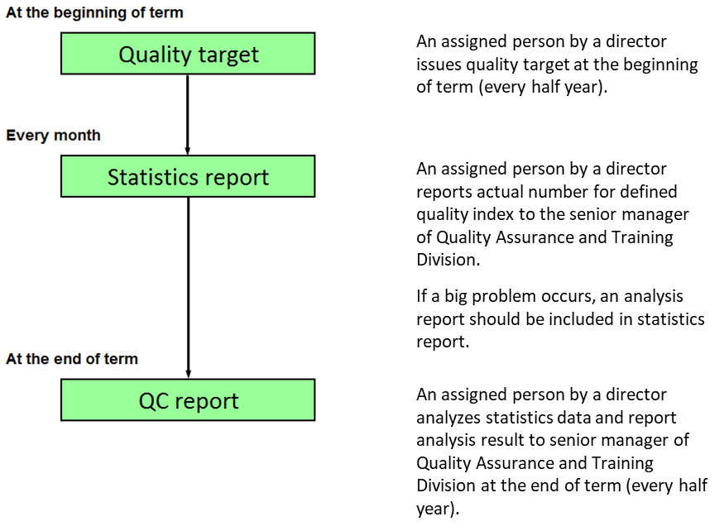
(1) QC Activity with ISO9001:2015
Quality Management System (required by ISO9001)
Scope/Target
Monitoring
Progress
Planning
Reporting
KPI Management Scheme
SEPG/Process Activity
QA Activity
QC Activity
Scope/Target of quality is defined as Quality Objectives (a.k.a KPI) which will be explained from next slides.

Slide 78
(2-1) Quality Objectives: Reference from REL/ABU
“In the ABU SW development, we set the following indicators as KPI.
The review engagement rate of the FD/DD process of the management indicator is managed as the completion condition of the FD/DD process to achieve the target.
The monitor indicator does not set the achievement as the process completion criteria, but it analyzes the difference between the actual result and the target.
We will analyze the measurement result of 2019/1H, we will review the target value after 2019/2H and consider changing the monitor index to management index.
The following is a list of KPIs.”
Indicator | Indicator type | Definition
Production Ratio (QM) | Management indicator | Completion scale / Effort of development (KL/Man-Month)
Production Ratio (ASIL) | Management indicator | Completion scale / Effort of development (KL/Man-Month)
Review engagement rate (FD) | Management indicator | Peer review effort in FD / Effort of FD process (%)
Review engagement rate (DD) | Management indicator | Peer review effort in DD / Effort of DD process (%)
Code review implementation rate (CD) | Monitor indicator | Peer review effort in CD / production scale (H/KL)
Test density (UT) | Monitor indicator | Number of test items / Production scale (item/KL)
Test density (IT) | Monitor indicator | Number of test items / Completion scale (item/KL)

Slide 79
(2-2) Quality Objectives: Reference from REL/ABU
Out of date ➔ under maintaining
“For the KPI on the previous page, we set the following target values, aiming at quality improvement and loss cost reduction.
※ For the monitor indicator, we plan to reset the target value based on the result of 2019/1H.”
Reference from REL ABU/QC
Indicator | Indicator type | 2019 | 2020 | 2021 | 2022
Production Ratio (QM) | Management indicator | - | 1.0 | 1.0 | ?
Production Ratio (ASIL) | Management indicator | - | 0.3 | 0.3 | ?
Review engagement rate (FD) | Management indicator | 6% or more | 8% or more | 10% or more | 12% or more
Review engagement rate (DD) | Management indicator | 6%or more | 8% or more | 10% or more | 12% or more
Code review implementation rate (CD) | Monitor indicator | 1.5 or more | 2.0 or more | 2.5 or more | 3.0 or more
Test density (UT) | Monitor indicator | 100 - 300 | 150 - 350 | 150 - 350 | 150 - 350
Test density (IT) | Monitor indicator | 50 - 150 | 75 - 175 | 75 - 175 | 75 - 175

Slide 80
(3) Quality Objectives
Out of date ➔ under maintaining
Quality objectives in RVC are defined as Quality, Cost, and Delivery (a.k.a. QCD in KPI management)
Quality: ability of a product or service to meet and exceed customer expectation
[KPI-main] Bug-after-release (BAR)
[KPI-sub] Accumulated number of checkpoint (CP) which the BAR passed through
[KPI-sub] Number of bugs caused by not applying known countermeasures among the BARs
[KPI-optional] Bug-leakage after acceptance test (AT)
[KPI-optional] Peer review engagement rate per process
Cost: minimizing the total development cost
[KPI-main] Defect ratio of product (upper phase vs. lower phase)
[KPI-optional] Review efficiency (bugs found by review vs. total bugs)
[KPI-optional] Defect removal efficiency (bugs found before release vs. total number of bugs)
Delivery: providing good customer service on time
[KPI-main] In-time release rate (released times vs. total released-delayed times)
[KPI-optional] Release commitment rate (released times vs. total adjust-cancel-released times)
[KPI-optional] Release cycle time (total time per release)
[KPI-optional] Open-Close ticket rate (story-point velocity or ticket velocity)

Slide 81
(3-1) Quality Objectives: Target from RVC ESW (19-1H)
Out of date ➔ under maintaining
Indicator (KPI-main) |  | Purpose | Target
Quality | Bugs-after-release (BAR) | Bugs caused by RVC and detected after release (including released inside RVC) | 2 or less
 | Check points which are passed through | Accumulated number of CPs which bugs detected after release passed through | 3 or less
 | Not applying countermeasure among BAR | Bugs caused by not applying known countermeasures among the bugs detected after release | ZERO
Cost | Defect ratio on upper phase | To detect the possible defects of upper phase (FD, DD, CD, UT) carried over lower phase (IT,ST) in order to avoid additional development cost. | 85% or more
Delivery | In-time-release milestone | To measure our commitment achievement to customer | 98.5% or more
Section/Group must follow to the KPI-main of ESW.
Section/Group can set the internal target for KPI-optional as effort of management and control.

Slide 82
(3-2) KPI: Design Defect (Quality Incident, Quality Issue)
Out of date ➔ under maintaining
Definition: a measurable value for the number of defects that were (1) detected by customer (end-user) (2) after Software Quality Qualification (QQ) process (RCT-JF1001) is finished, and (3) within one year from date of the QQ process.
It is used to understand the quality of delivered product under the viewpoint achieving ZERO defect/bug after final release.
For a fair judgement, the project should cover both upper phase and lower phase, such as DD+CD and UT+IT or full-phase development from FD to ST. It is to ensure the responsible of RVC for the target keeping high quality status.
A simple (understanding) flow when it happens…
Target is going to ZERO
Bug after release
(1) Send immediate report to manager + QA + QC
(2) Handle bug analysis and bug fixing plan
(3) Handle 5-Why analysis and apply countermeasure

Slide 83
(3-3) KPI: Checkpoint which are pass-through
Out of date ➔ under maintaining
Definition: a measurable value for the accumulated number of checkpoints (CP) pass-through when the bug after release caused until it is detected.
It is used to understand the quality of later phases under the viewpoint defects detection can be covered by later phases even with higher cost.
The number of CPs are 6 including Project Planning, Requirement Development, Function/Architecture Design, Detail/Unit Design, Coding, and Testing ^{(*)}. The accumulation is started to count from the next CP of the CP that cause the defect to the CP before the QQ process ^{(**)}.
Under the JB5001 development process, defect is counted from PP, and hence the maximum number of CPs that can be count for one case (JB5001) is 5, starting from the RD.
Note:
^{(*)}: Unit Test, Integration Test, and System Test are count as one CP Testing.
^{(**)}: For example, the defect after release is detected for the release after the QQ process, and the cause analysis shows that the defect belongs to the scope of Function Design, then the total number of CPs pass-through are three CPs which are including Detail Design, Coding, and Testing.

Slide 84
(3-4) KPI: Not applying known countermeasure
Out of date ➔ under maintaining
Definition: a measurable value for the number of defects caused by not applying known countermeasures among the bugs after release.
It is used to understand whether the countermeasures are shared to all related members to prevent it will happen again in the future.
In RVC history, there were 29 countermeasures were collected and mapped into 7 common items under development process
➔ the violation can be detected via QA activity before a release.
Common countermeasures
Lack of peer review / code review
Insufficient test preparation
Lack of skill evaluation and training plan
Lack of baseline checking
Lack of configuration management
Countermeasure
Improvement of development process
Improper risk management and monitoring
Lack of traceability and requirement analysis
Optional, since some projects didn’t involve QA
Contribute the improvement to QA
Non-Compliance issue confirmed by QA
Projects follows to development process
If yes
Occurred
Confirm if the improvement of development process was applied as project planned.
Count to the KPI
Bug after release

Slide 85
(3-5) KPI: Bug-leakage after acceptance test
Out of date ➔ under maintaining
Definition: a measurable value for number of bugs-leakage after acceptance test of release milestone.
It is used to understand the efficiency of bug detection before the acceptance test.
The acceptance test is assumed to be handled outside the development team. In the case a part of test suit is shared with development team for the internal test effort and confirmed NO bug, however bugs are detected lately after a release milestone and hence still be counted as bug-leakage after acceptance test.
Basic features A
Design
Code
Test
Alpha
Beta1
Beta2
Beta3
Final
Features B + bugs fixing (A)
Design
Code
Test
Features C + bugs fixing (A)
Design
Code
Test
Bug after release
Any bug found after the Final release is called as bug after release.
After each release milestone Alpha, Beta1, Beta2, Beta3 and Final release, bugs found and covered by the release condition will be counted as bug-leakage after acceptance test.
For instance, after Beta1, any bug found for feature A and B will be counted as bug-leakage after acceptance test. The features C are still on development progress and NOT covered by the release condition, hence their bugs found are NOT counted for this KPI.
Features D + bugs fixing (B) (C)
Design
Code
Test
Maintenance for A, B, C, D
Design
Code
Test

Slide 86
(3-6) KPI: Peer review engagement rate
Definition: a measurable value for the rate of peer review effort comparing with effort spent on the design-coding phases.
The rate is set as engagement (commitment) of project on the effort to handle enough peer review.
If the actual value is lower than the commitment, NOT enough peer review is handled and the risk of leaking bug to later phases is high.
If the actual value is higher than the commitment, cost of good quality (COGQ) is too high.
Average | 7.98%
Standard deviation | 4.38%
UCL | 21.13%
LCL | 0.00%
Average +30% | 10.38%
Average -30% | 5.59%
Average | 8.16%
Standard deviation | 5.01%
UCL | 23.18%
LCL | 0.00%
Average +30% | 10.61%
Average -30% | 5.71%
Average | 8.39%
Standard deviation | 5.65%
UCL | 25.34%
LCL | 0.00%
Average +30% | 10.91%
Average -30% | 5.87%
FD
DD
CD
This is the control chart of review engagement rate from RVC Process Database V4.1
From the Process Database V4.1, it’s recommended to set the target review engagement rate at 8% (3.2 hours per every 40 working-hours) for design-coding!

Slide 87
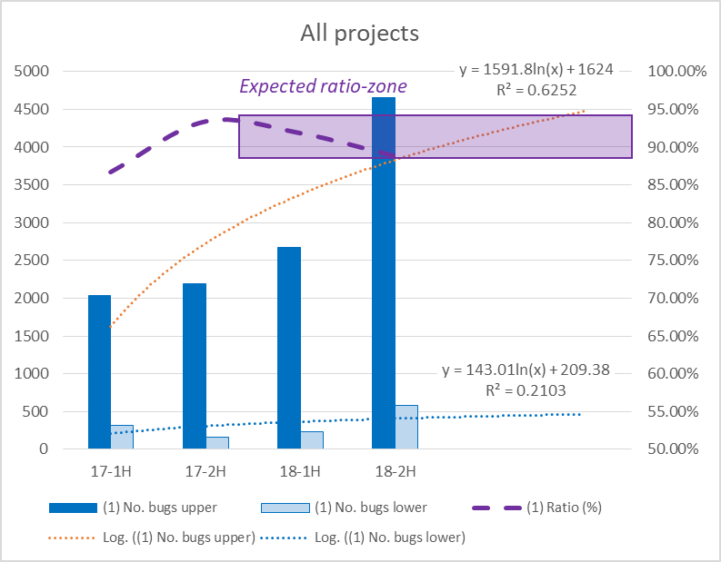
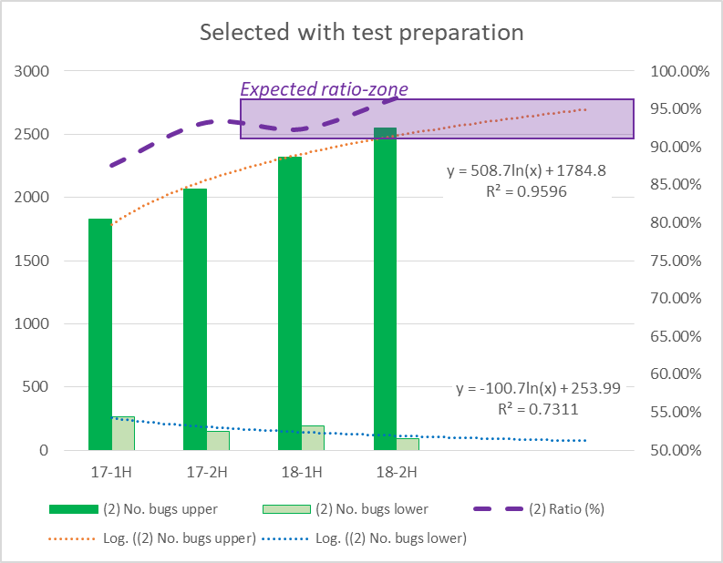
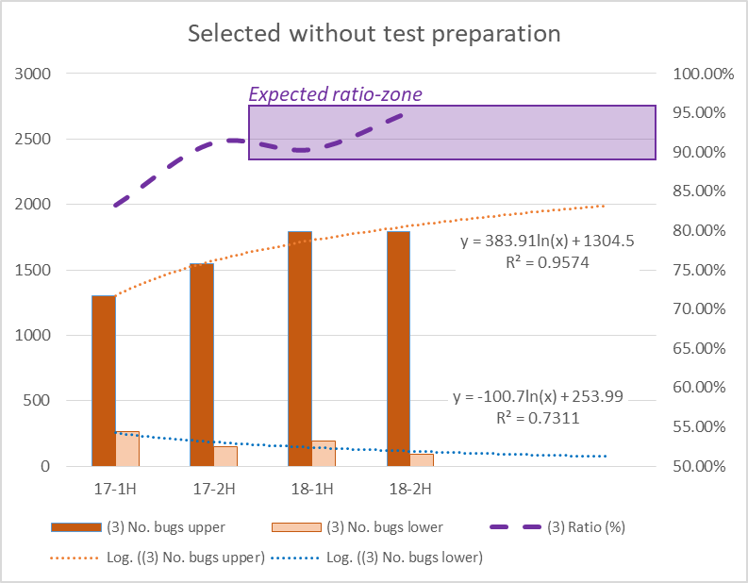
(3-7) KPI: Defect Ratio on Upper phase
Definition: a measurable value for the defect ratio based on the number of defects detected in upper phases comparing with the total number of defects detected in both upper phases and lower phases.
It is used to understand the capability of detecting defects in upper phases under the assumption that early detecting defects in upper phases is better as the cost to fix defects detected in lower phases is much higher.
Bugs are from all projects that are mixing the development types. It's used to build the measurement of development capability of RVC where all projects have somewhat relationship together as Renesas product.
Bugs are from selected projects that exclude those provided ambiguous and inaccuracy data after a study on project background. The test preparation (UTP, ITP, STP) is also merged as a part of upper phase to compare with the bugs of lower phase in which may include the test env. issues.
Bugs selected projects that exclude those provided ambiguous and inaccuracy data after a study on project background. The test preparation (UTP, ITP, STP) is excluded as an intention of focusing on the product development issues.

Slide 88
(3-8) KPI: Review Efficiency
Definition: a measurable value for the efficiency of peer review effort for detecting bugs comparing with total bugs found during development phase.
It is used to understand whether the peer review can detect all possible bugs rather than relying only to the test execution.
Formula: Review efficiency = number of bugs found in review / total number of bugs caused on phase
Number of bugs found in review is counted only for the review.
Total number of bugs caused on phase is count for the bugs caused on a particular phase.
The review efficiency can be larger than 1.0 (100%) since the bugs found in review may include the bugs caused by previous phases (leakage bug).
Peer review in test execution should make clear for the target, since it’s mixing issues between test items, test code, and the target product. Hence, the review efficiency should be analyzed following to each target separately.

Slide 89
(3-9) KPI: Defect Removal Efficiency
Definition: a measurable value for the ability of detecting and removing known defects prior to a release.
It is used to understand the capability of resolving defects when making a release.
Formula: Defect removal efficiency (DRE) = number of bugs resolved / total number of bugs
Number of bugs resolved is counted before a release.
Total number of bugs is including number of bugs caused and number of bugs leaked.
Also total number of bugs means number of bugs resolved and number of bugs unresolved.
Basic features A
Design
Code
Test
Alpha
Beta1
Beta2
Beta3
Final
Features B + bugs fixing (A)
At Alpha, testing of A is to satisfy the release condition for A.
Despite of the fact that Alpha release accepts the bugs leakage, DRE should be counted for bugs resolved targeting to the Alpha release.
Design
Code
Test
Features C + bugs fixing (A)
Design
Code
Test
Bug after release
Any bug found after the Final release is called as bug after release.
Features D + bugs fixing (B) (C)
Design
Code
Test
At Beta1, the release condition is changed to cover both B and bugs fixing (leaked) A.
The features C may be implemented in parallel with B as sample code or experiment and then contains some bugs. However, since C is not the target of Beta1 release, DRE should be counted for bugs resolved both A and B only.
Maintenance for A, B, C, D
Design
Code
Test
At Final, unresolved bugs can be set as limitation or restriction following to the negotiation with customer, otherwise the Final release is failed as a result. However, they should be counted as unresolved bugs to evaluate DRE under development viewpoint.

Slide 90
(3-10) KPI: In-Time-release milestone
Definition: a measurable value for the in-time-release milestone ratio based on the number of in-time-release milestones comparing with the total number of proceeded milestones in project.
It is used to understand the achieved commitment of project for both the external milestone (requested by customer) and internal milestone (project planning).
Quantitative report for milestones achievement (18-1H vs 18-2H)
In-time release milestones: 100% (plan >=98.5%)
In-time release milestones: 99.38% (plan >=98.5%)

Slide 91
(3-11) KPI: Release commitment rate
Definition: a measurable value for the commitment rate of release milestones comparing with plan.
It is used to against the plan adjustment or milestone cancellation with the assumption that they will impact to the customer’s plan.
Formula: Release commitment rate = number of non-modified in-time releases / total releases
Number of non-modified in-time release is counted only for the in-time release without adjustment.
Total releases is including the in-time release, delayed release, cancelled release, and each time adjusted schedule.
Since the adjusted schedule may occur and be counted as 01 time failed-commitment, the release commitment rate could be less than 100% even though all releases were handled in-time.

Slide 92
(3-12) KPI: Release Cycle time
Definition: a measurable value for the spinoff of cycle time (man-hour) per release.
It is used to understand the time (workload) from when a release began to when it was shipped.
Tracking Release Cycle Time will help to identify areas for improvement (decrease time to/between releases) and set expectations if the team wants to have regular releases.
With a trending over time, it can help to raise flags on bottlenecks and process inefficiencies affecting release delivery.

Slide 93
(3-13) KPI: Open-Close Ticket rate
Definition: a measurable value for the pacing of the team on delivery expectation.
It is used to understand the velocity to achieve the delivery expectations and also to understand if the team is blocked (falling velocity) or if the process changes are working (stable or increased velocity).
The velocity in some cases is volatile due to many reasons, however it always has a deviation range that can be controllable.
If the velocity is at high volatility, something was broken in the process and team and need to be investigated for a fixing.
If the velocity is at low volatility, trending can be used to forecast the next targets of delivery.

Slide 94
(4) Collection model
Quality objectives in RVC are defined as Quality, Cost, and Delivery (a.k.a. QCD in KPI management)
A collection model is required to gather the quality objectives (KPI) result following to 02 approaches:
Monitoring KPI: the intermediate result of KPI is monitored timely for a purpose of regular control, then a gap between target and actual (intermediate result) is analyzed in order to have intermediate actions to take back the control.
If the defect ratio is set as monitoring KPI, then the team still have chances to add more reviews on upper phase or confirm again the test execution in lower phase in order to take back the normal defect ratio.
Management KPI: the target is set as achievement, hence the gap between target and actual values is NOT evaluated and a regular control is NOT required since there is no solution to improve the actual result when it happened. However, an intermediate report is required as soon as the issue happened.
If the review engagement rate is set as management KPI, then the team needs to use all reserved reviewing slots to achieve the target review rate ➔ they cannot withdraw the target.
If the bug after release is set as management KPI, then the team cannot do anything with the management KPI after the bug is reported ➔ the bug is counted, and target could be failed.
The collection model to handle Monitoring KPI and Management KPI is explained from next slides.

Slide 95
(4) Collection model
Report KPI-Quality: bug after release
KPI: Quality, Cost, Delivery
Report KPI-Cost: defect ratio
ESW
Report KPI-Delivery: in-time release milestone
Section
Group 1
QC monthly report
Group 2
QC monthly report
QC team
QC member
Internal KPI B
QC member
QC member
QC member
Internal KPI A
(Acting)
(Acting)
Prj 1
Prj 2
Prj 3
Prj 4
Prj 5
Cooperation between Manager and QC member to handle the organization KPI report.

Slide 96
(4) Collection model
Report KPI-Quality: bug after release
Report KPI-Cost: defect ratio
ESW
Report KPI-Delivery: in-time release milestone
1. Proving the development capability
Section
2. Predicting quality trend
Group 1
Group 2
ANALYSIS
QC team
QC member
MEASUREMENT
QC member
QC member
QC member
(Acting)
(Acting)
Prj 1
Prj 2
Prj 3
Prj 4
Prj 5
Cooperation between Manager and QC member to handle the organization KPI report.
QC activity @ Group-level should focus on the total quality by comparing between projects, and predicting quality trend.

Slide 97
(4) Collection model
Report KPI-Quality: bug after release
Report KPI-Cost: defect ratio
ESW
1. Proving the development capability
Report KPI-Delivery: in-time release milestone
2. Predicting quality trend
Section
3. Defining improvement
Group 1
Group 2
QC team
QC member
QC member
QC member
QC member
(Acting)
(Acting)
Prj 1
Prj 2
Prj 3
Prj 4
Prj 5
Cooperation between Manager and QC member to handle the organization KPI report.
QC activity @ Group-level should focus on the total quality by comparing between projects, and predicting quality trend.
Evaluating both organization KPI and internal KPI in each Group will contribute to KPI management @ ESW

Slide 98
(4-1) Collection model – A Survey on defect ratio
Refer to slide (3-7) KPI: Defect Ratio on Upper phase
18-2H
19-1H
19-2H
Project A
Should count the project A, B, D, E from the beginning (starting of Project Planning phase) until the end of 19-1H
Project B
Project C
Do NOT count the project C, because it was finished before new period!
Project D
Project E

Slide 99
(4-2) Collection model – A Survey on Measurable Data
Background of situation
There are several data collection templates following to the development process (V-model vs Agile), then some measurable data is missing from templates ➔ lack of data to build up the organization Process Database and evaluate the organization capability.
Under the development process, there are some cases that the project prefer to skip handling Measurement and Analysis activity ➔ there is no record from project to build up the organization Process Database and evaluate the organization capability.
Solution
A survey on measurable data will be sent to some target/selected projects for every 6 months to collect the necessary information, then PM and PL need to provide the information through the survey.
The survey will target to the common measurable data similar to the JB5001 development process for analyzing and building up the organization Process Database.
It is better if the project can provide the measurable data regularly following to the development process, then the survey is NOT necessary for them since the measurable data is already available to collect.

Slide 100
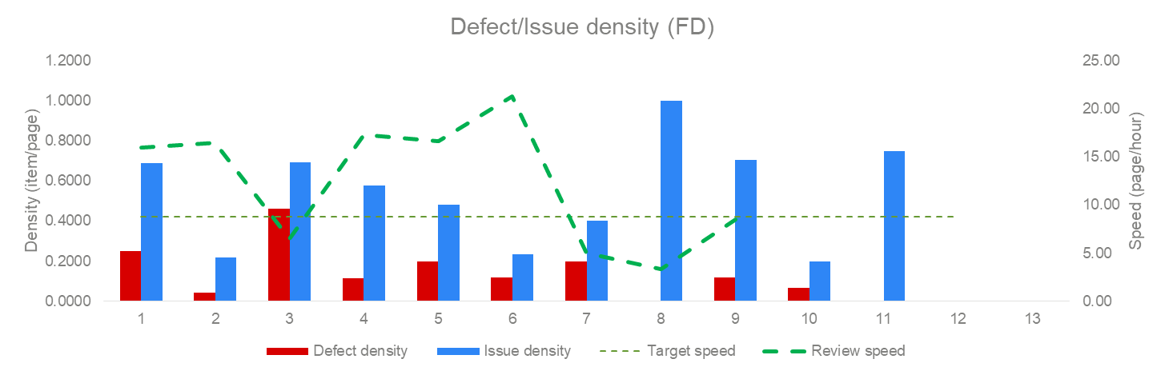
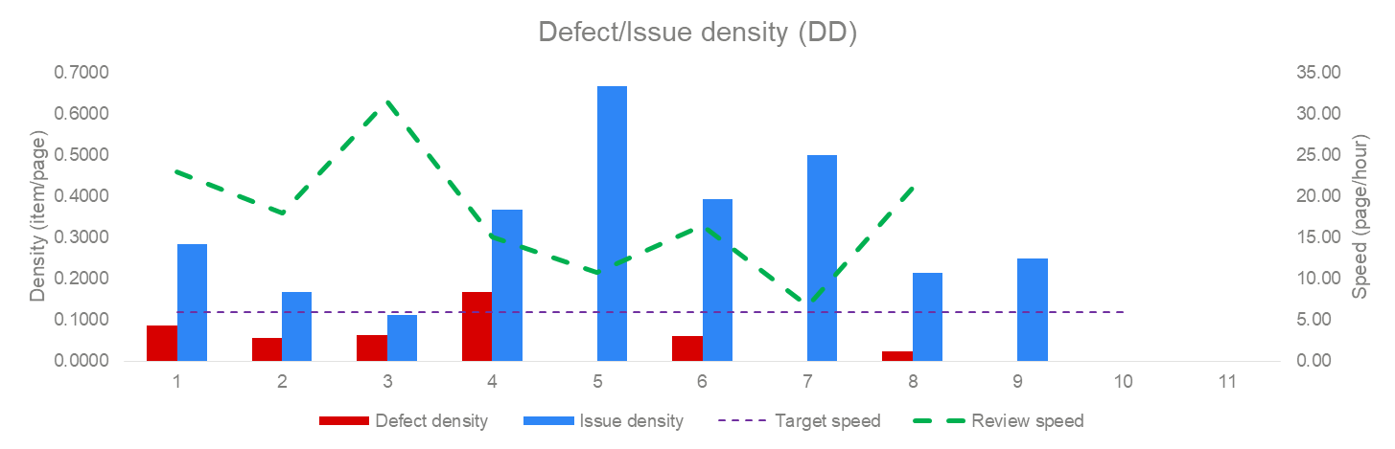
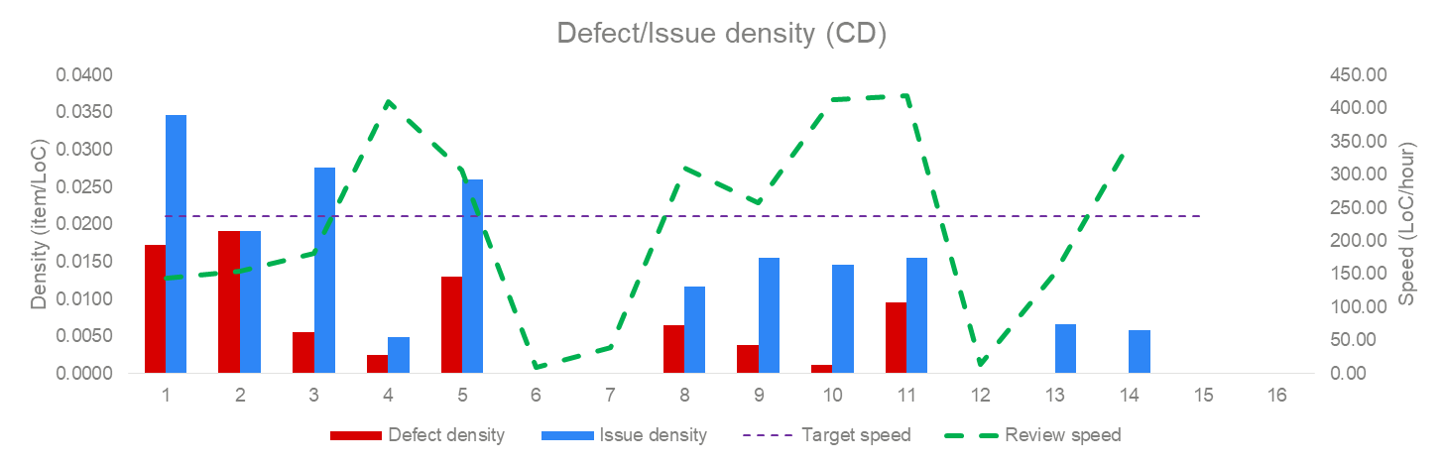
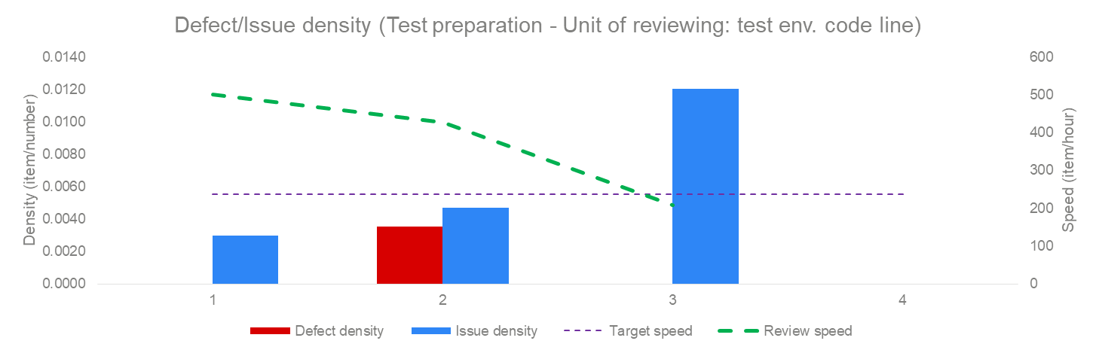
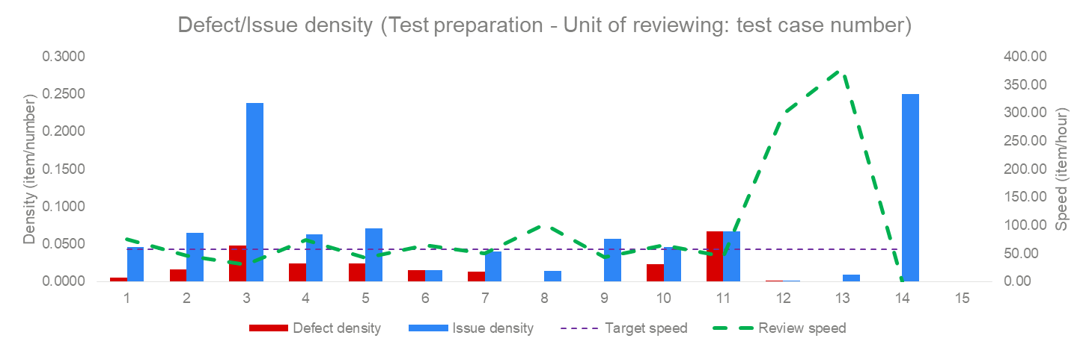
(4-3) Collection model – Peer review parity
Background of situation
The review scope and unit are different among development phases and projects ➔ It’s not easy to make a comparison between them to study about quality trend and making a forecast.

Slide 101
(4-3) Collection model – Peer review parity
Background of situation
The review scope and unit are different among development phases and projects ➔ It’s not easy to make a comparison between them to study about quality trend and making a forecast.
Assumption for making the parity
The review scope and effort spent for reviewing should be stable and can be measured.
When the peer review is stable, then an amount of source code for reviewing can be exchanged for an amount of document for reviewing. That’s what we called “the parity”.
To calculate the parity, average review speed from Process Database V4.1 is used as base of exchange.
The unit of parity is then measured as hour, which means the amount of workload is being expected to review the work items comparing with the average review speed.
1. Review speed of FD : 16.00863 pages/hour
2. Review speed of DD : 18.72294 pages/hour
3. Review speed of CD : 610.369 lines/hour
4. Review speed of UTP : 105.2067 cases/hour
5. Review speed of UT test spec : 21.12121 pages/hour
6. Review speed of ITP : 122.6792 cases/hour
7. Review speed of IT test spec : 30.12908 pages/hour
8. Review speed of STP : 85.54954 cases/hour
9. Review speed of ST test spec : 30.9 pages/hour
10. Review speed of test env. : 243.0224 lines/hour
11. Review speed of test result UT : 415.8166 cases/hour
12. Review speed of test result IT : 719.7012 cases/hour
13. Review speed of test result ST : 207.5466 cases/hour
Example of peer review parity
If the project took a CD peer review for 1000 lines of code, exchange it to the review parity as:
1000 / 610.369 = 1.63.
If the project took a UTP peer review for 100 test cases, exchange it to the review parity as:
100 / 105.2067 = 0.95.
In total, the accumulated review parity is:
1.63 + 0.95 = 2.58.

Slide 102
(5) Quality management Meeting
Project measurable data collection
Host: QC leader, QA leader
Conductor: QC members, PM/PL
Project development management file collection (monthly)
Survey on project measurable data (quarterly)
Quality Management Meeting (Monthly)
Quality Management Meeting (Monthly)
Quality Management Meeting (Monthly)
Section
Project Measurement and Analysis reports
Host: Manager
Conductor: QC member
Participants: PM/PL/Staff and Senior engineers
Internal KPIs report
Organizational KPIs report (self-control)
Quality Management Meeting (Monthly)
ESW
Organizational KPIs report
Host: Director
Conductor: QC leader, QA leader, WG leader
Participants: Mangers, PM/PL, key persons
Process compliance (PM + SWQA) and SEPG
Working group of improvement on Quality and ISO activity
SWDD Indicators (quarterly)
Measurement and Analysis reports at levels of group projects and department

Slide 103
(5) Quality management Meeting
Project measurable data collection
Host: QC leader, QA leader
Conductor: QC members, PM/PL
Project development management file collection (monthly)
Survey on project measurable data (quarterly)
Quality Management Meeting (Monthly)
Quality Management Meeting (Monthly)
Quality Management Meeting (Monthly)
Section
Project Measurement and Analysis reports
Host: Manager
Conductor: QC member
Participants: PM/PL/Staff and Senior engineers
Internal KPIs report
Organizational KPIs report (self-control)
Quality Management Meeting (Monthly)
Section Quality Management Meeting will:
Control quality status via KPIs commitment.
Focus to analyze issues and share with the projects the feedback.
Organize Quality Management Meeting between Manager, QC member, PM/PL and project key persons.
The meeting is quite similar to the weekly follow-up meeting but scheduled monthly to recognize the effectiveness of improvements on the weakness.
ESW
Organizational KPIs report
Host: Director
Conductor: QC leader, QA leader, WG leader
Participants: Mangers, PM/PL, key persons
Project will:
Process compliance (PM + SWQA) and SEPG
React to the feedback, make the plan to improve and share the status.
Working group of improvement on Quality and ISO activity
SWDD Indicators (quarterly)
Measurement and Analysis reports at levels of group projects and department

Slide 104
(5) Quality management Meeting
ESW Quality Management Meeting:
QC Leader reports about intermediate-status of KPIs, general measurement and analysis to determine the overall quality status.
QA Leader reports the process-compliance issues and their status
PPQA results (number of PPQA audits, number of NC/FC issues)
Highlighted issues (overdue issues, NC type-A, delayed DR events, etc.)
SEPG Leader shares some important process-related information
JB5001 standard, Global SEPG guidelines and templates
Good practices and current issues ➔ how to resolve
Quality matters working group leaders share the status of AIs.
Some special reports from the Section-level that were chosen to be shared.
Project measurable data collection
Host: QC leader, QA leader
Conductor: QC members, PM/PL
Project development management file collection (monthly)
Survey on project measurable data (quarterly)
Quality Management Meeting (Monthly)
Section will:
React to the feedback, make the plan to improve and share the status.
Quality Management Meeting (Monthly)
Quality Management Meeting (Monthly)
Section
Project Measurement and Analysis reports
Host: Manager
Conductor: QC member
Participants: PM/PL/Staff and Senior engineers
Internal KPIs report
Organizational KPIs report (self-control)
Quality Management Meeting (Monthly)
ESW
Organizational KPIs report
Host: Director
Conductor: QC leader, QA leader, WG leader
Participants: Mangers, PM/PL, key persons
Process compliance (PM + SWQA) and SEPG
Working group of improvement on Quality and ISO activity
SWDD Indicators (quarterly)
Measurement and Analysis reports at levels of group projects and department

Slide 105
END

